Slide 1
Solving linear equations graphically using technology
Solving linear equations

Slide 2
how to use Oak lessons

Slide 3
I can explore how to solve linear equations graphically via dynamic software.

Slide 4
An equation is used to show two expressions that are equal to each other.
The solution to an equality is the value which, when substituted, maintains the equality between the expressions.

Slide 5

Solving linear equations graphically using technology
Solving equations with unknowns on one side
Solving equations with unknowns on both sides

Slide 6
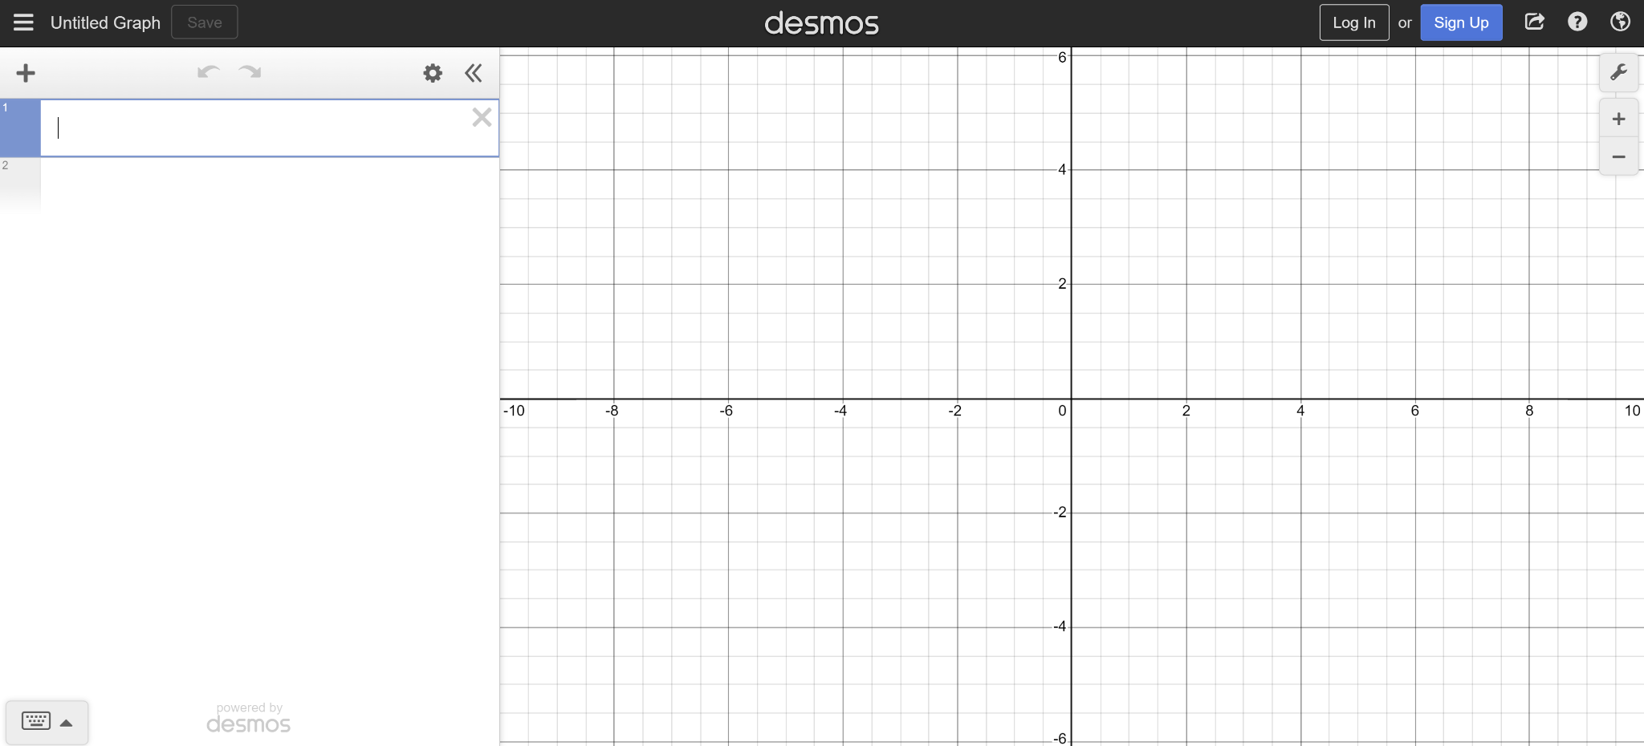
Solving equations with unknowns on one side
To get started:
Open up a web browser and go to desmos.com
Find and press the ‘graphing calculator’ button
Your screen should look like this

Slide 7
Solving equations with unknowns on one side
Use the graph settings to adjust your axes settings

Slide 8
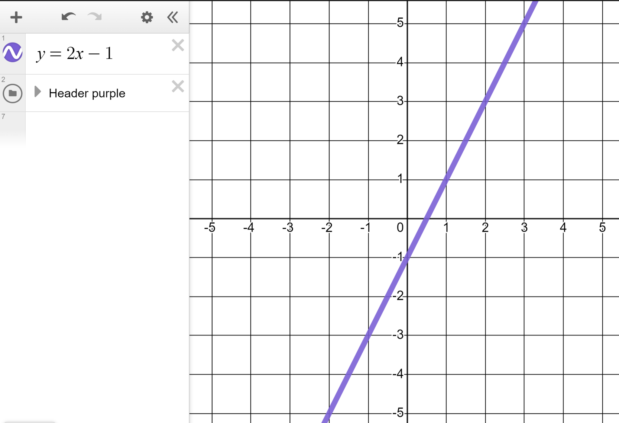
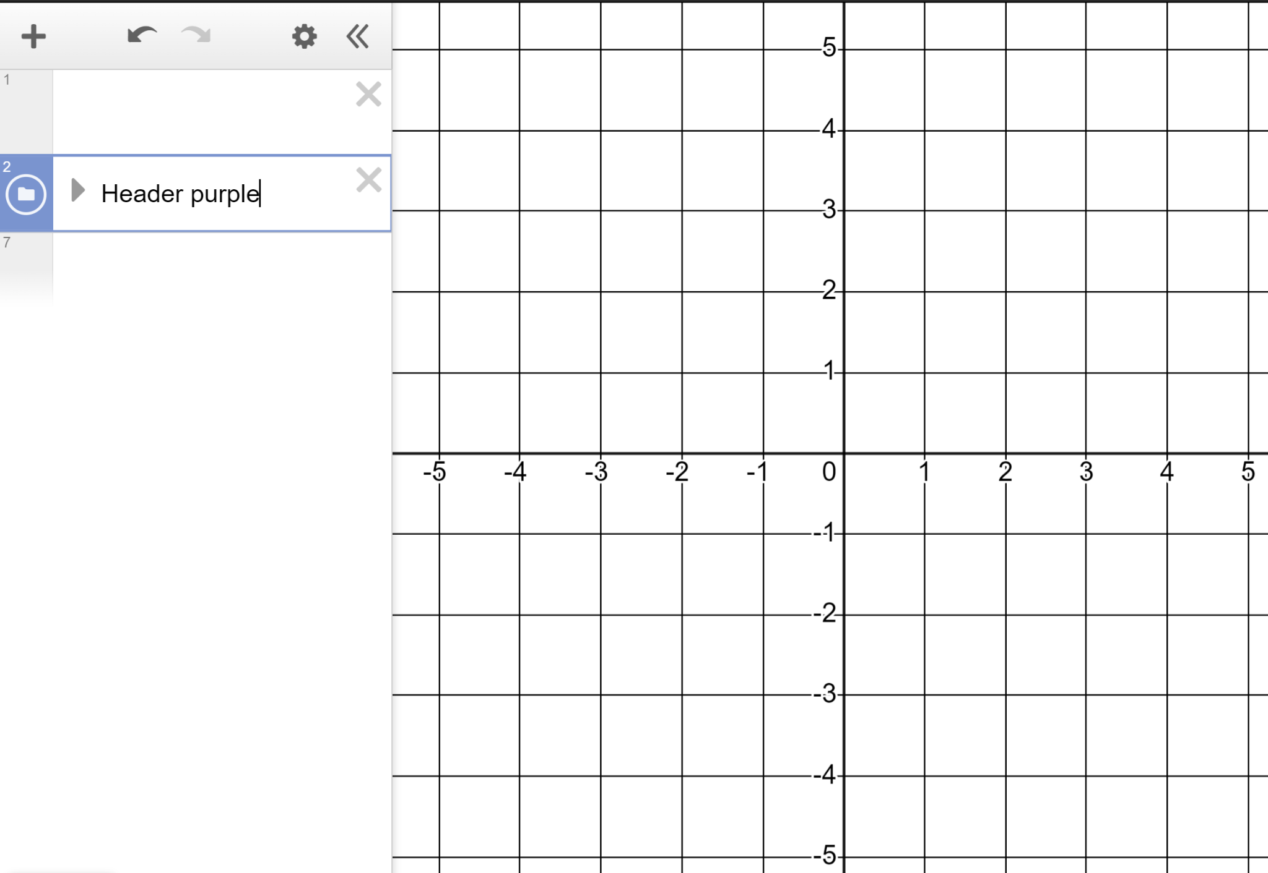
Solving equations with unknowns on one side
We’re now ready to explore solving equations.
Zoom and drag so your screen is scaled like this, with −5 to +5 visible on both axes.
Type y = 2x − 1 here
Desmos will draw the line y = 2x − 1 for you.

Slide 9
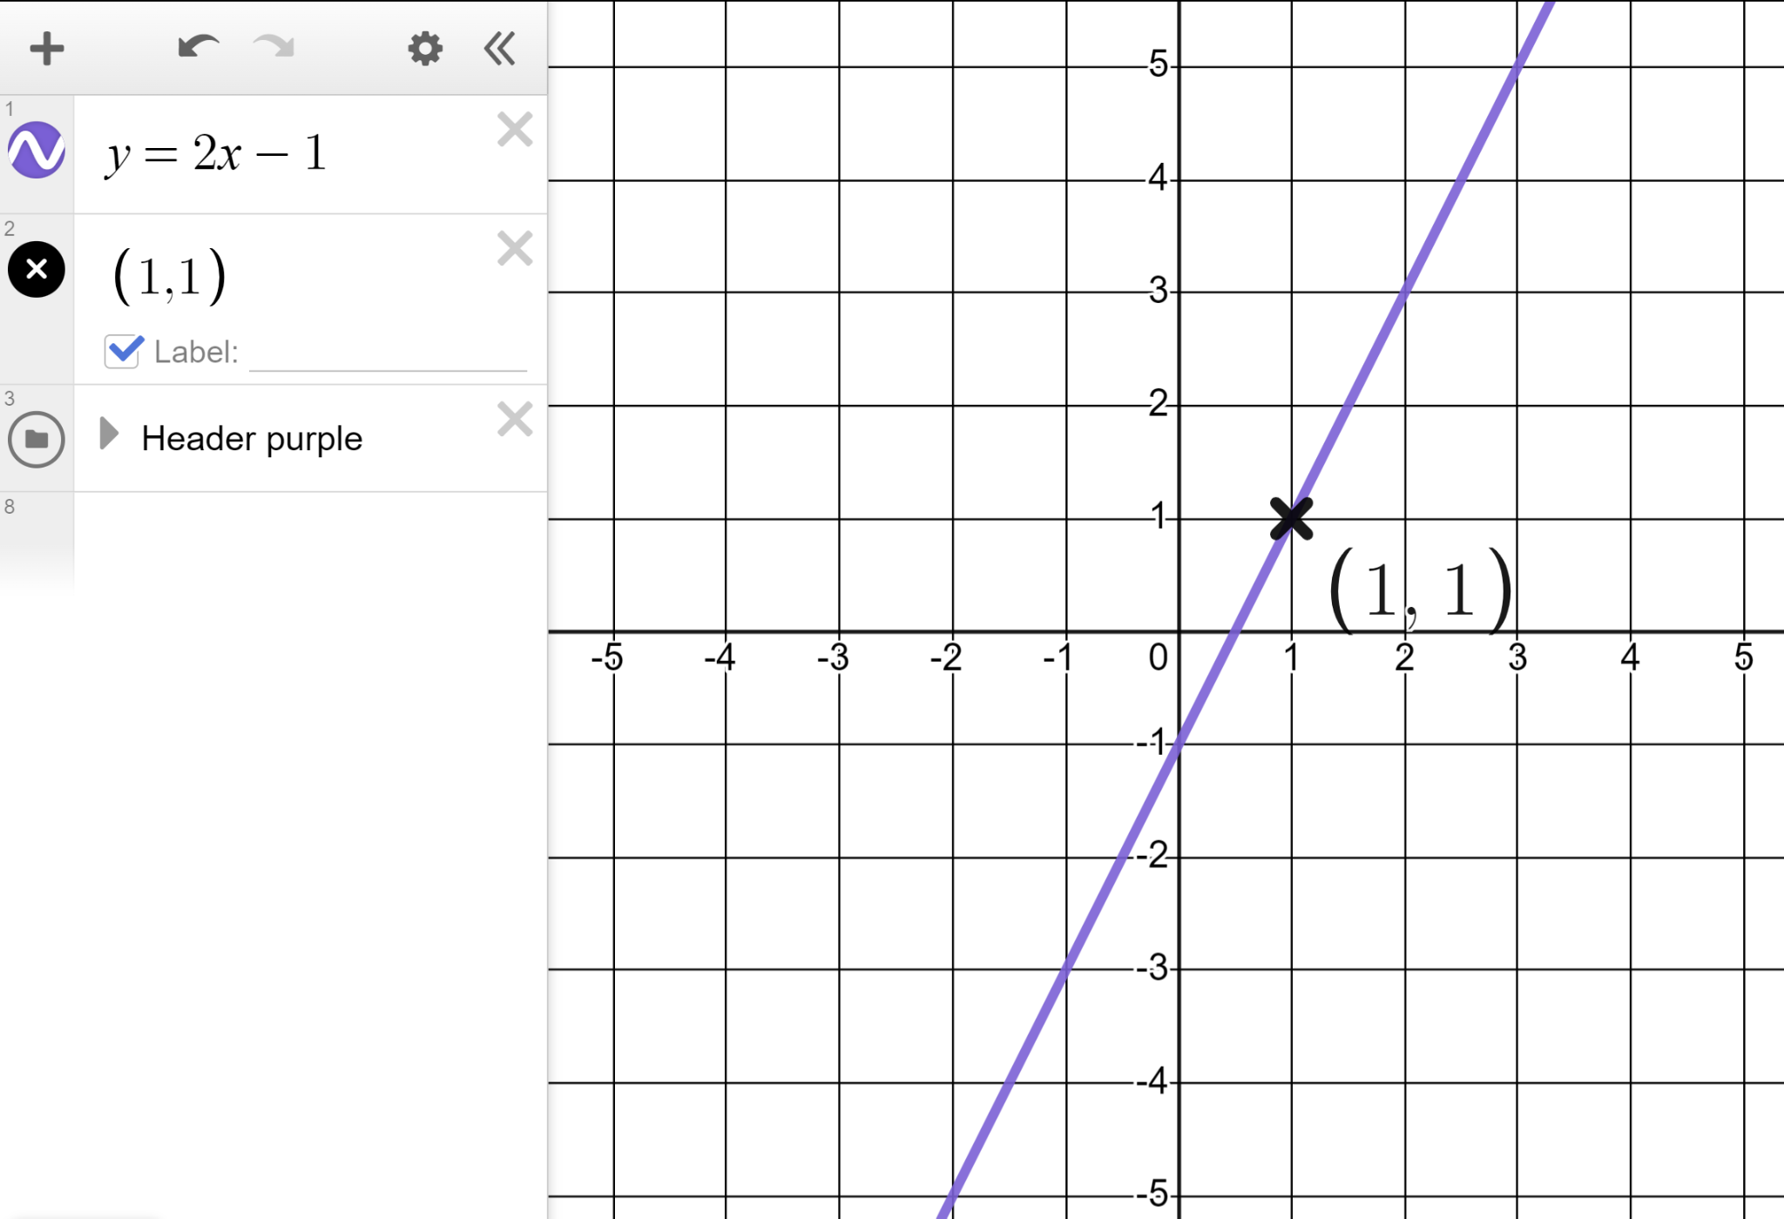
Solving equations with unknowns on one side
What integer value coordinates can you read from this section of the graph of y = 2x − 1?
Add the coordinates and label them. One is already done for you.
Click and hold here to change your coordinates to crosses, label them, and adjust the text size.

Slide 10
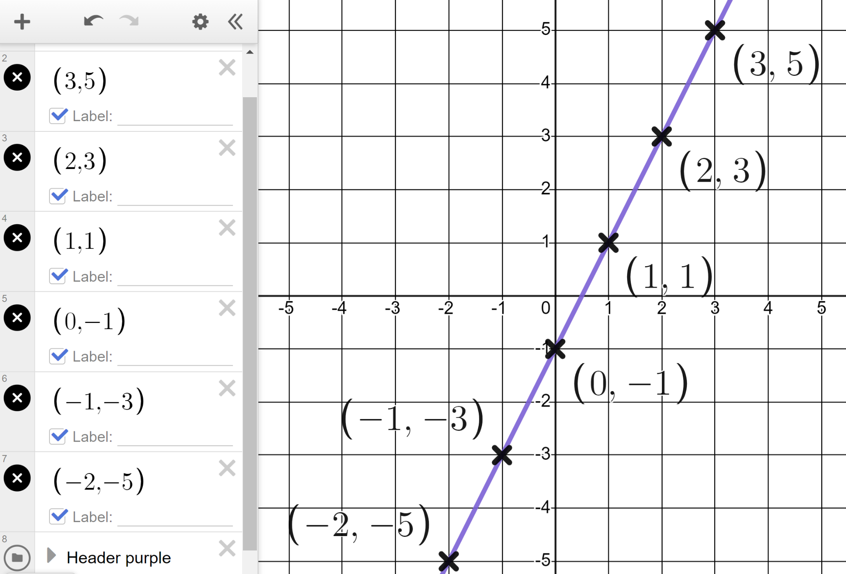
Solving equations with unknowns on one side
We get this set of coordinate pairs from y = 2x − 1
(3, 5) (0, −1)
(2, 3) (−1, −3)
(1, 1) (−2, −5)
Let’s consider the first coordinate pair in more detail

Slide 11
Solving equations with unknowns on one side
One coordinate pair on the line y = 2x − 1 is (3, 5)
When the x-value is 3 the y-value is 5
If x = 3 then 2x − 1 = 5
If 2x − 1 = 5 then x = 3
This is the solution to the equation 2x − 1 = 5
The solution to an equality is the value which, when substituted, maintains the equality between the expressions.

Slide 12
Solving equations with unknowns on one side
Fill in the blank values in the statements about coordinate (2, 3)
(3, 5)
When the x-value is 3 the y-value is 5
If x = 3 then 2x − 1 = 5
If 2x − 1 = 5 then x = 3
(2, 3)
When the x-value is 2 the y-value is 3
If x = 2 then 2x − 1 = 3
If 2x − 1 = 3 then x = 2

Slide 13
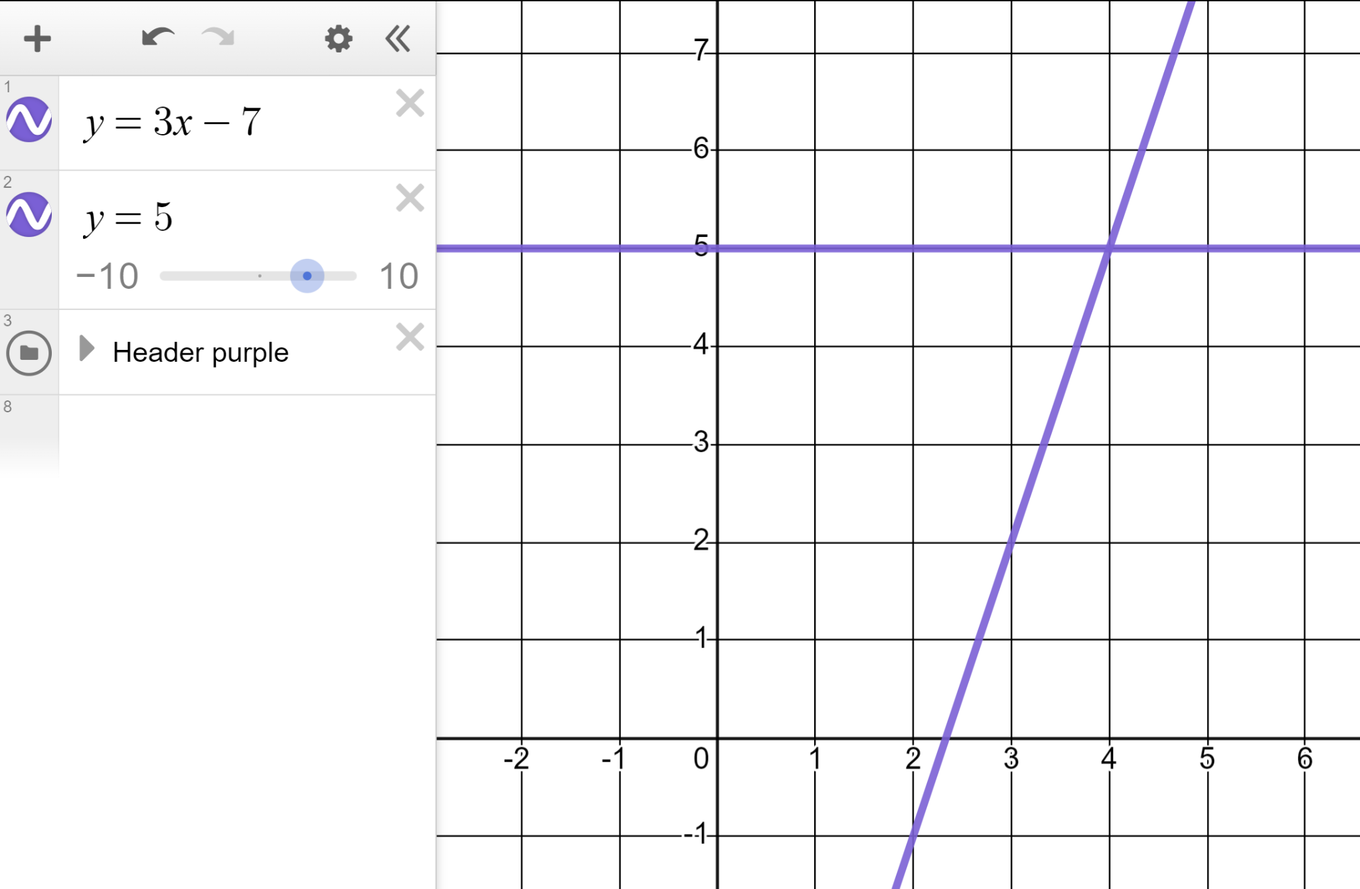
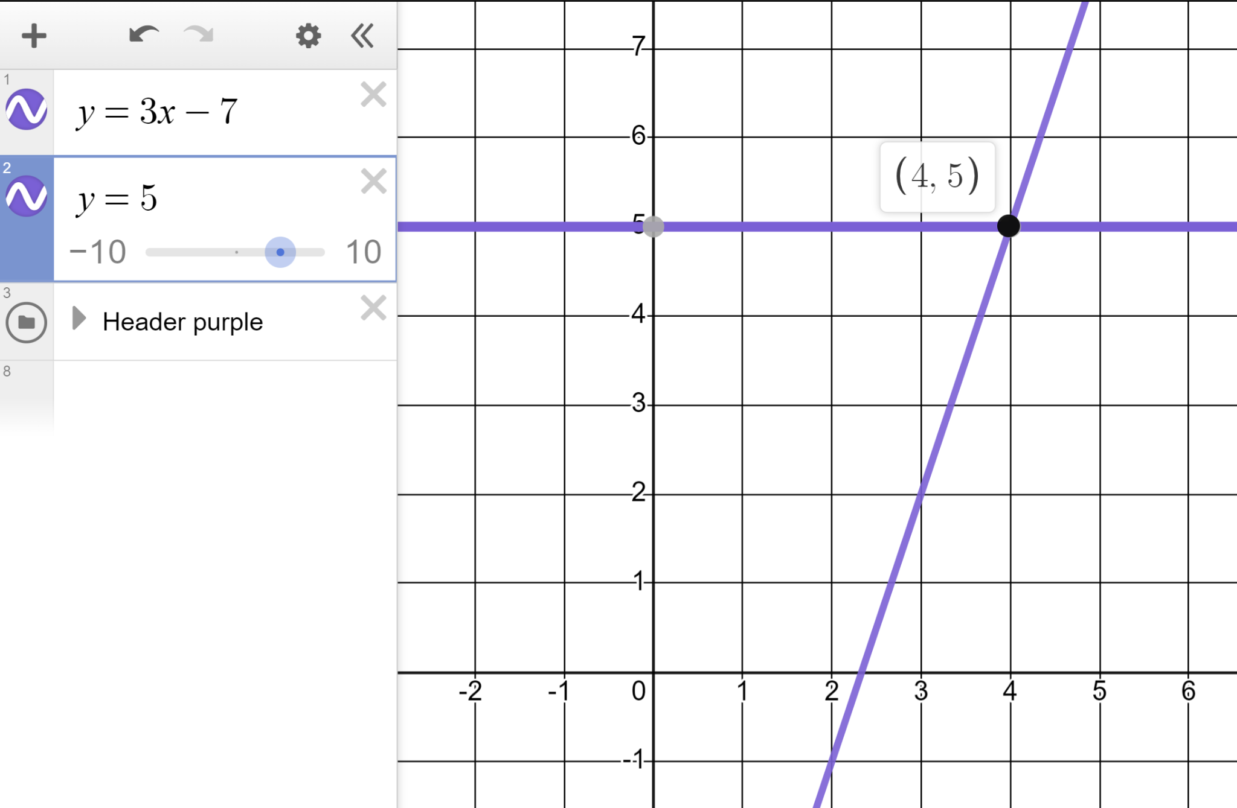
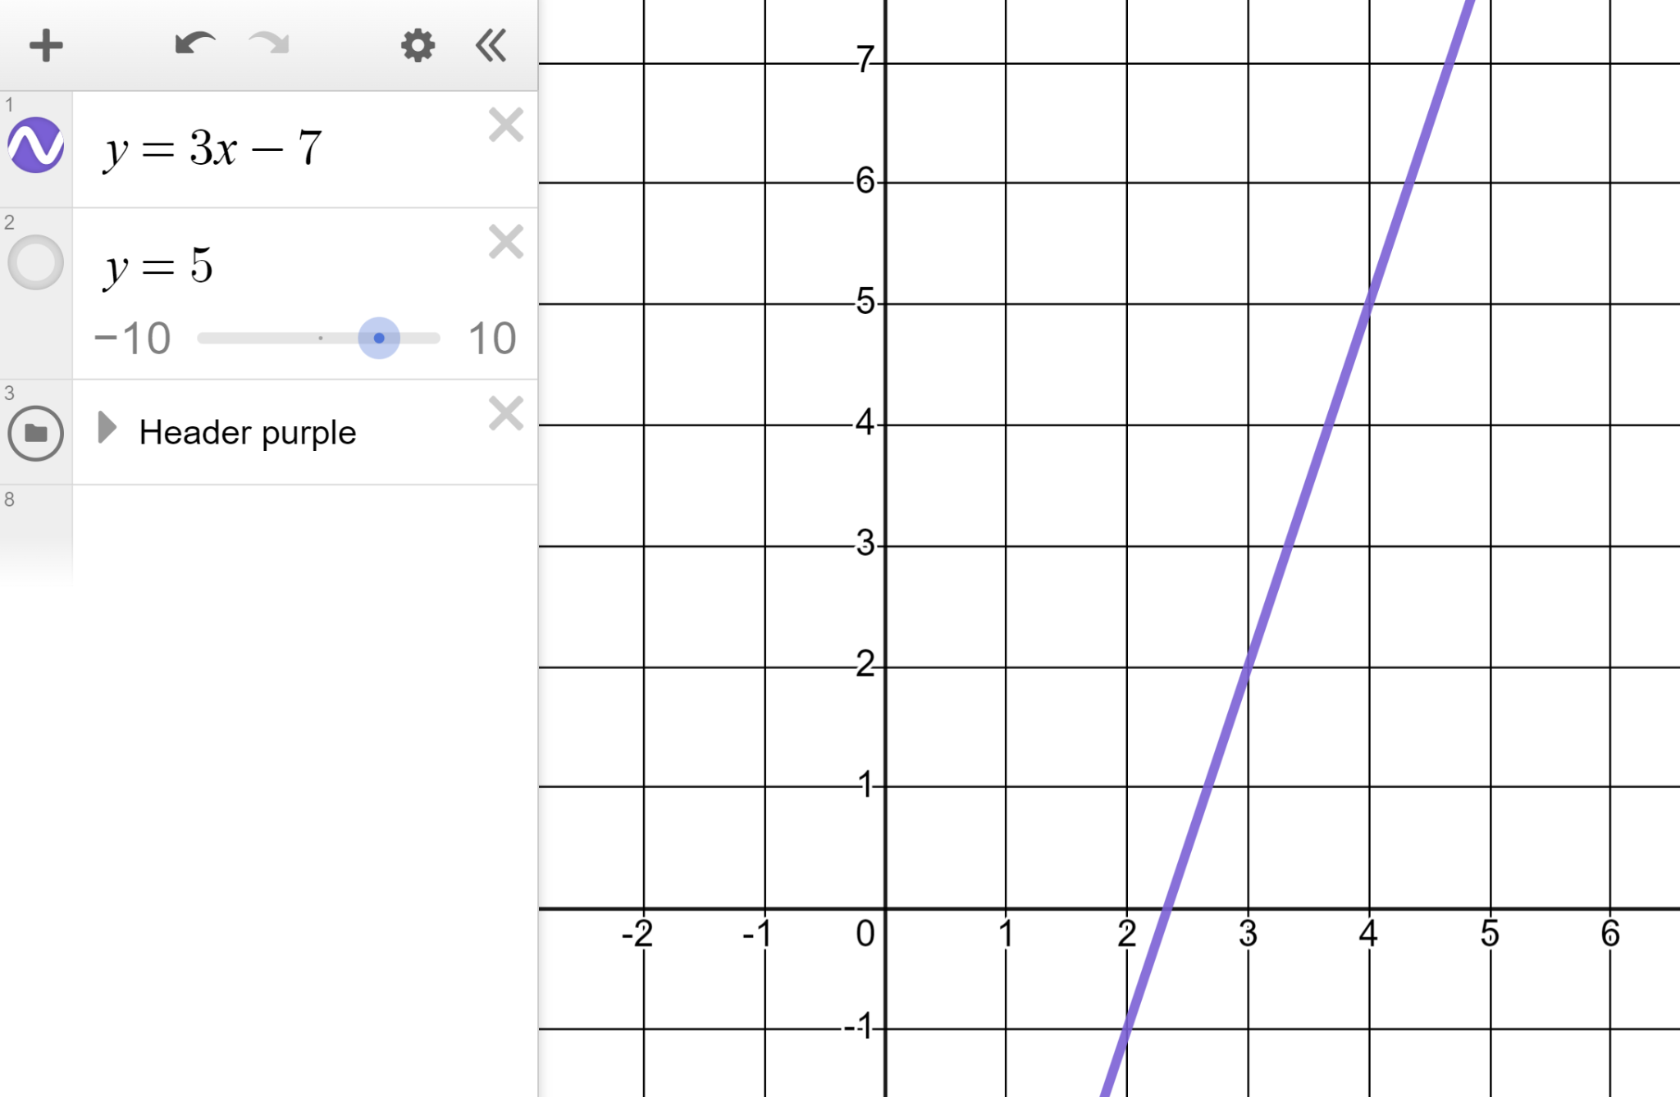
Solving equations with unknowns on one side
There is an easier way to solve equations than finding coordinates all the time.
Solve 3x − 7 = 5
We could read this as when does the line y = 3x − 7 meet with the line y = 5
Click on the meeting point of the two lines and Desmos will reveal the coordinate is (4, 5)
Our solution is when x = 4

Slide 14
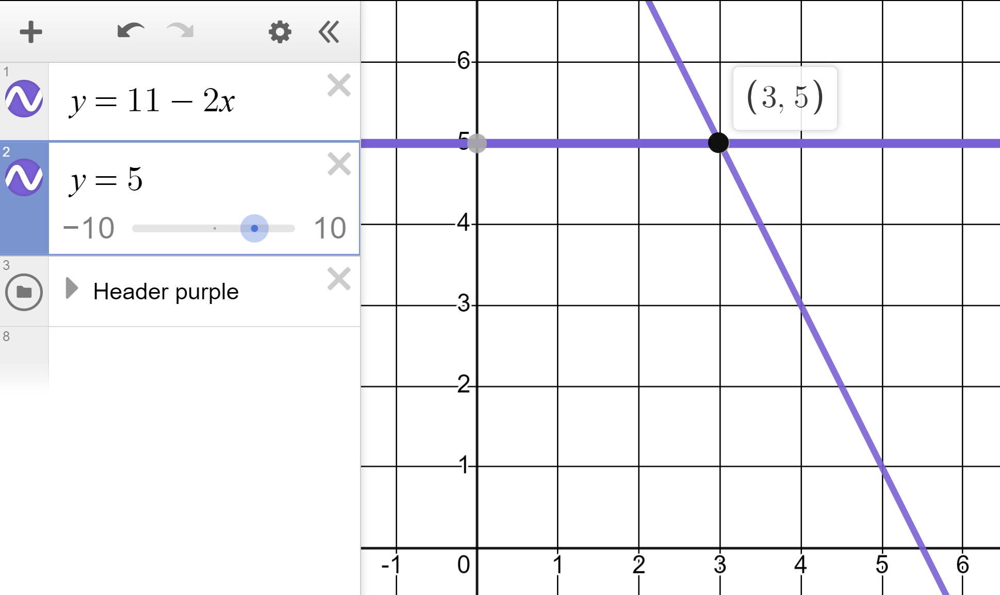

Solving equations with unknowns on one side
What does this image tell us?
The solution to 11 − 2x = 3 is x = 5
The solution to 11 − 2x = 5 is x = 3
The expression 11 − 2x is only equal to 5 when the x = 3
The solution to 11 − 2x = 5 is x = 5

Slide 15
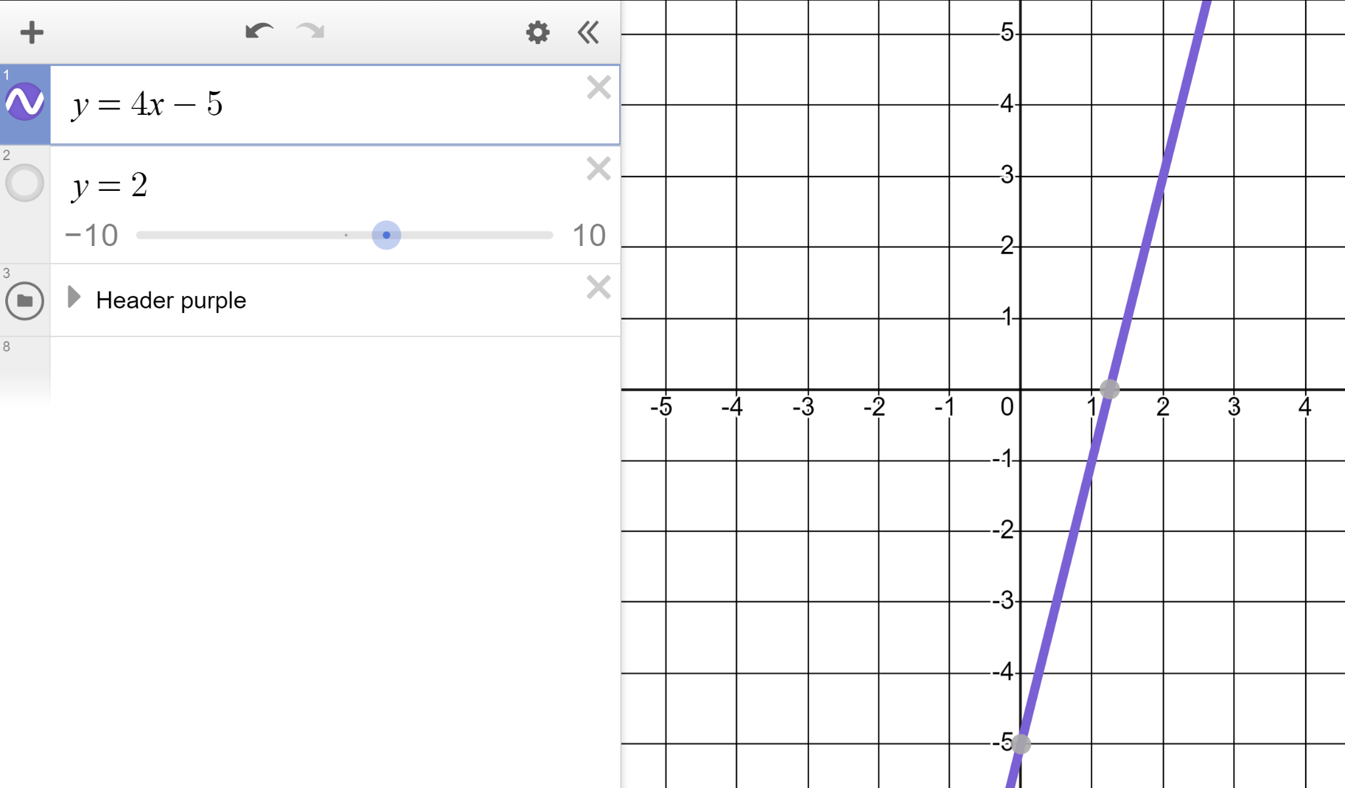
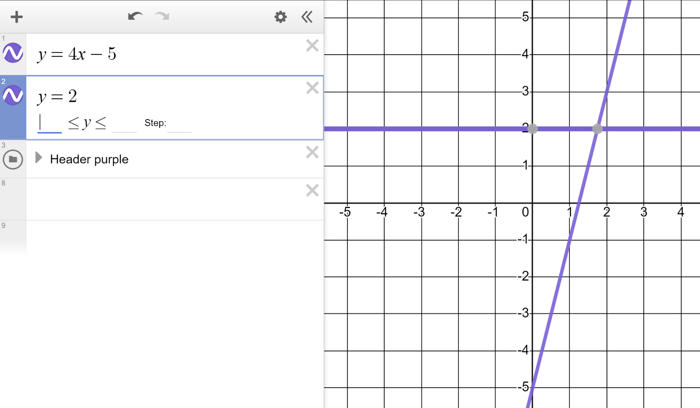
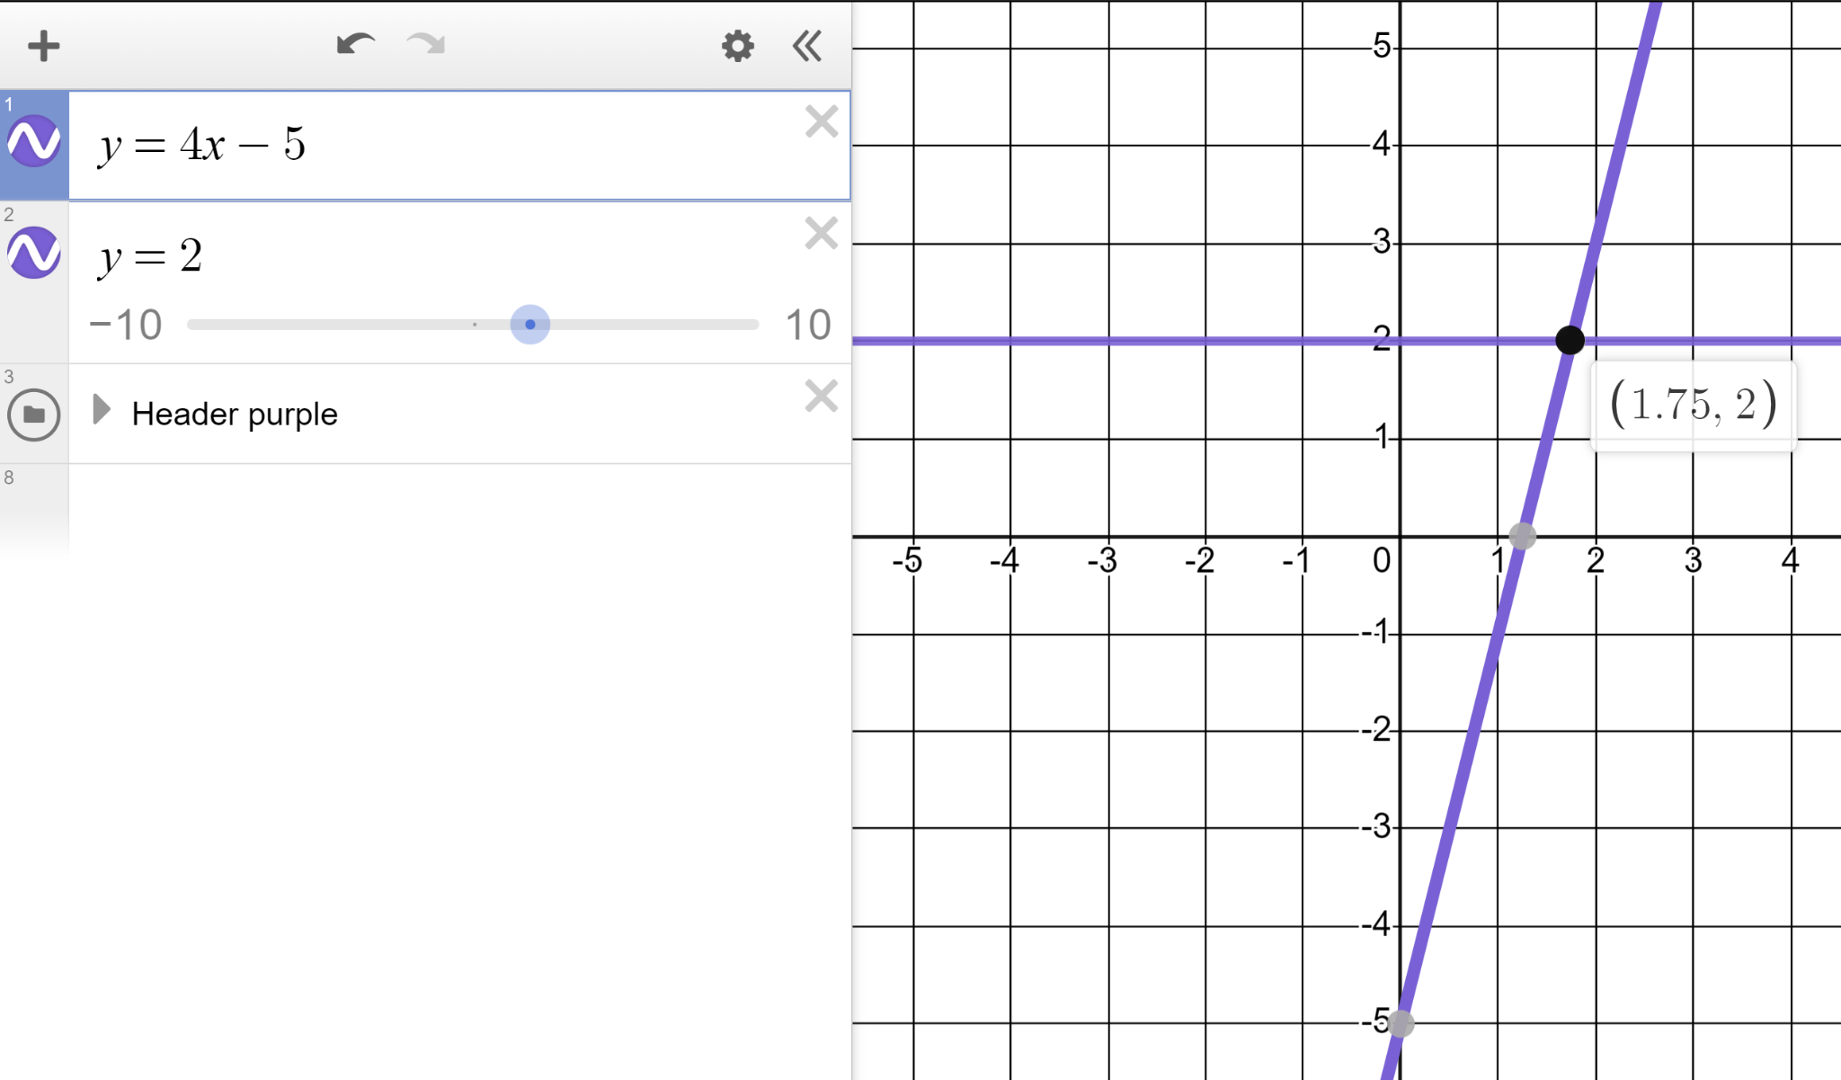
Solving equations with unknowns on one side
Plot the line y = 4x − 5
Plot the line y = 2
Solve 4x − 5 = 2
(1.75, 2)
If x = 1.75 then 4x − 5 = 2
If 4x − 5 = 2 then x = 1.75
x = 1.75 is the only value which maintains equality.

Slide 16
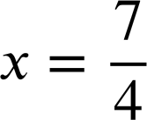
Solving equations with unknowns on one side
How does this solution compare to when we solve without graphing?
4x − 5 | = | 2
4x − 5 | = | 2
4x | = | 7
In written notation we would leave the solution as a fraction for simplicity. However, Desmos will always give you a decimal.
In written notation we would leave the solution as a fraction for simplicity.
(1.75, 2)
If x = 1.75 then 4x − 5 = 2
If 4x − 5 = 2 then x = 1.75
x = 1.75 is the only value which maintains equality.

Slide 17
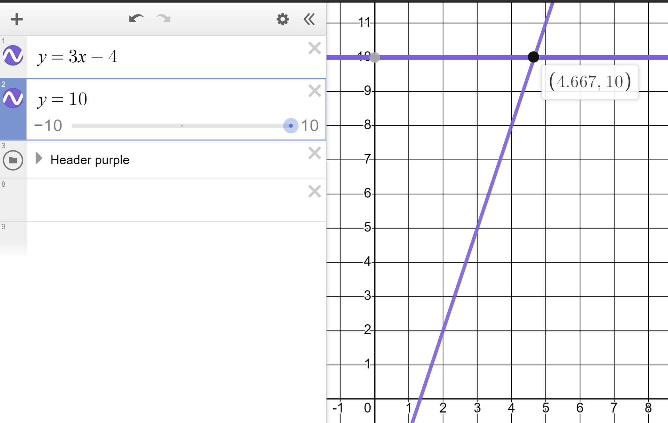
Solving equations with unknowns on one side
This image shows us the exact solution to 3x − 4 = 10 is x = 4.667

Slide 18
Solving equations with unknowns on one side
This image shows us the exact solution to 3x − 4 = 10 is x = 4.667
.
x = 4.666666… = 4.6 is the exact solution in decimal form.
x = 4.666 is the exact solution.
x = 4.667 is an approximate solution accurate to 3 d.p.

Slide 19
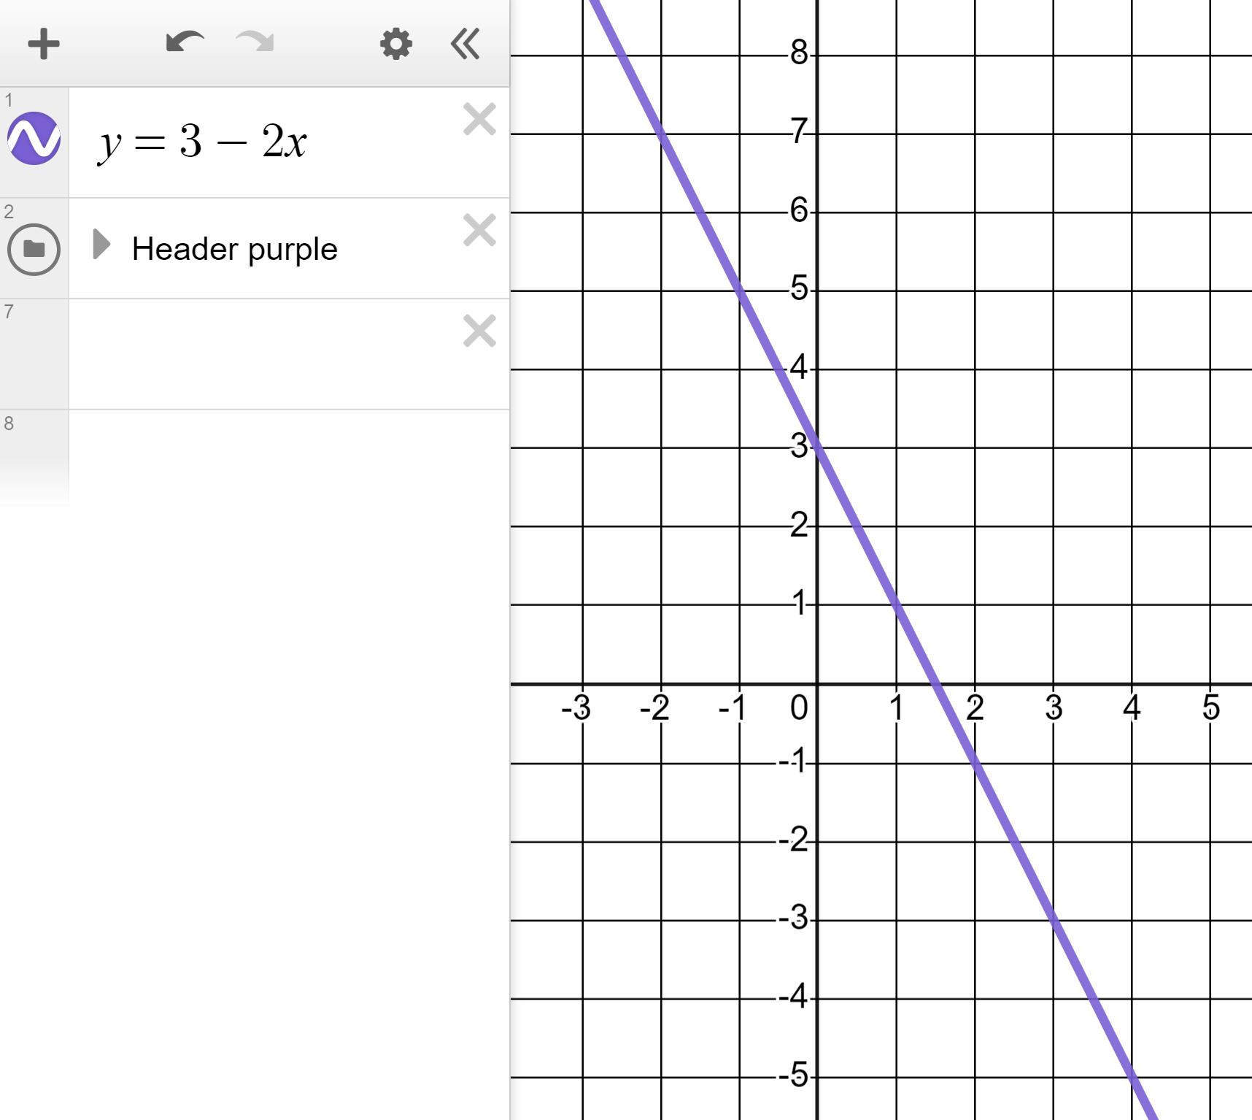
Solving equations with unknowns one side
1) Draw the line y = 3 − 2x and use it to solve the below equations.
a)
3 − 2x = 1
b)
3 − 2x = −5
c)
3 − 2x = 5
d)
3 − 2x = 3

Slide 20
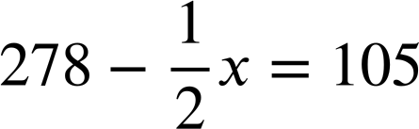
Solving equations with unknowns one side
2) Draw two lines for each to find the solutions to these equations:
a)
5x − 7 = 13
b)
c)
2.1x + 3.7 = 2.608

Slide 21
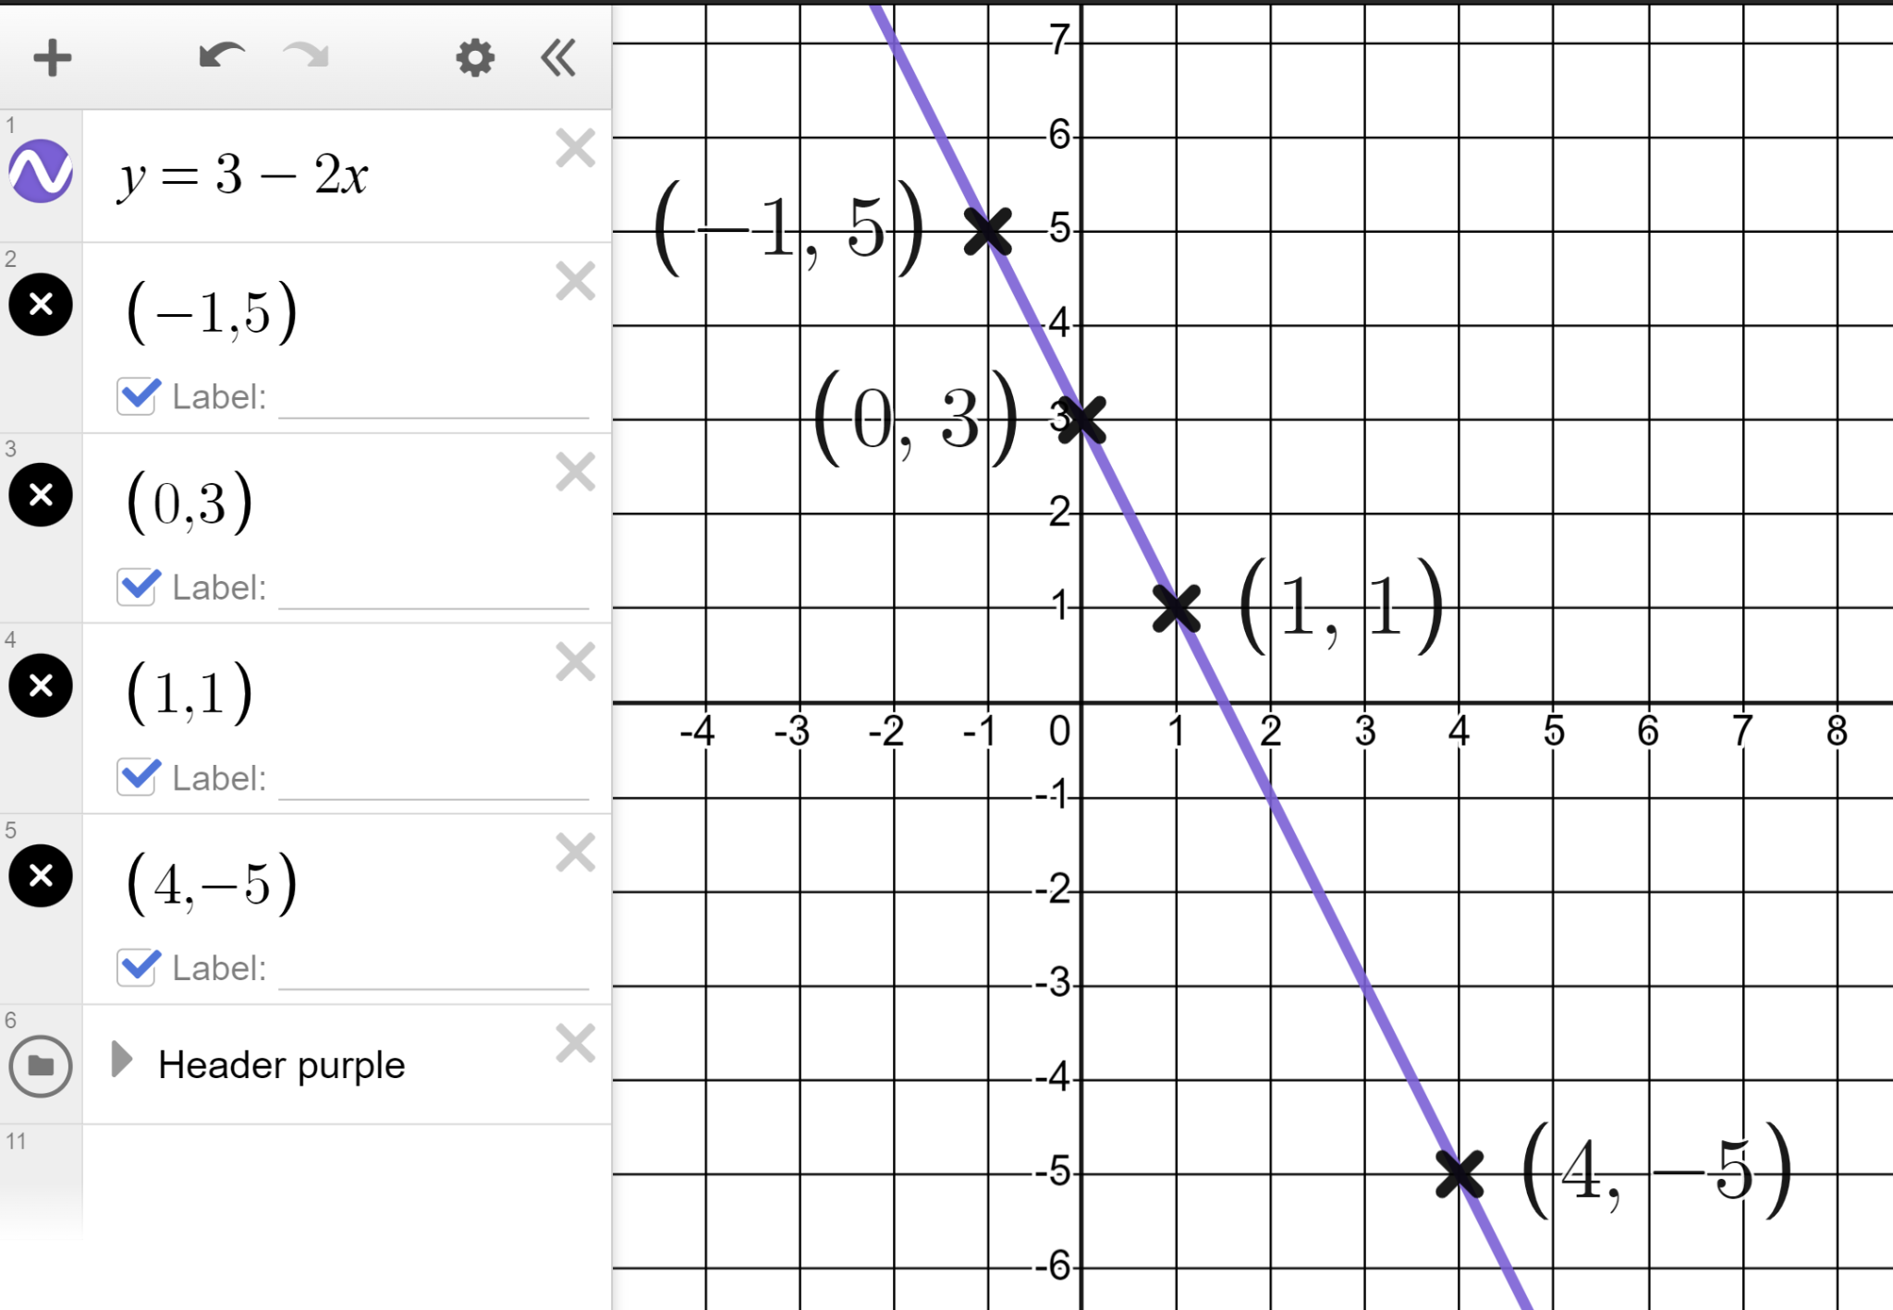
Solving equations with unknowns one side
1) Draw the line y = 3 − 2x and use it to solve the below equations.
a)
3 − 2x = 1
x = 1
b)
3 − 2x = −5
x = 4
c)
3 − 2x = 5
x = −1
d)
3 − 2x = 3
x = 0

Slide 22
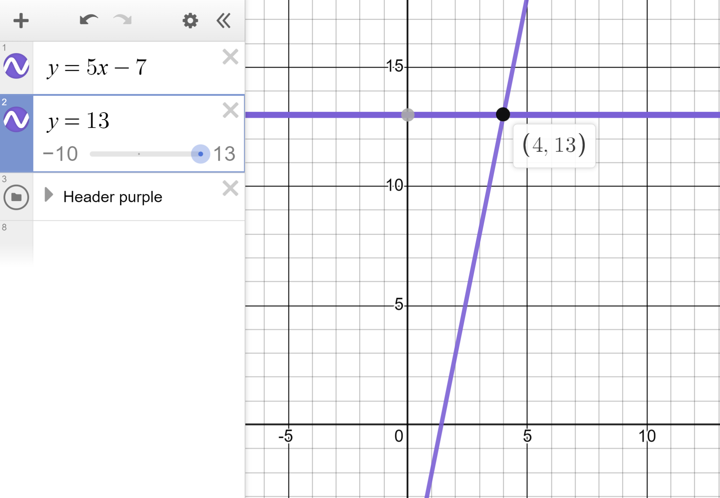
Solving equations with unknowns one side
2) Draw two lines for each to find the solutions to these equations:
a)
5x − 7 = 13
x = 4

Slide 23
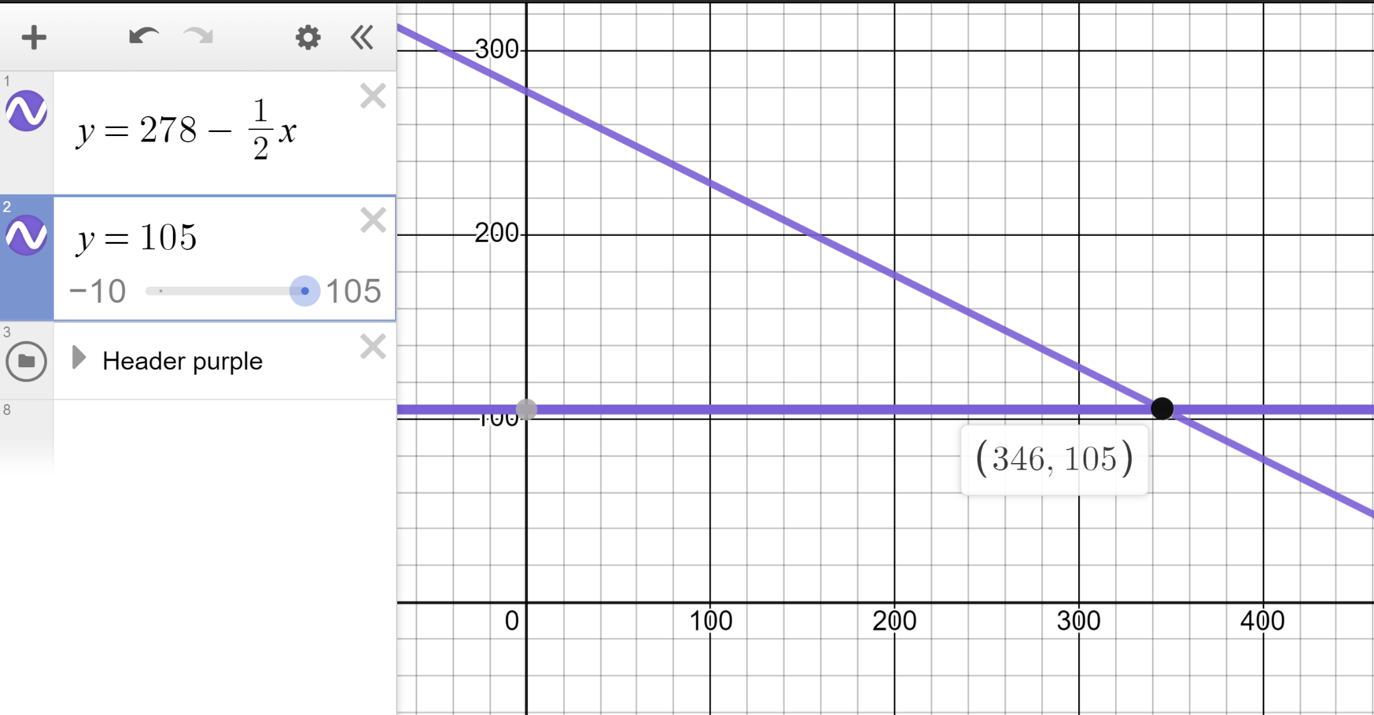
Solving equations with unknowns one side
2) Draw two lines for each to find the solutions to these equations:
b)
x = 346

Slide 24
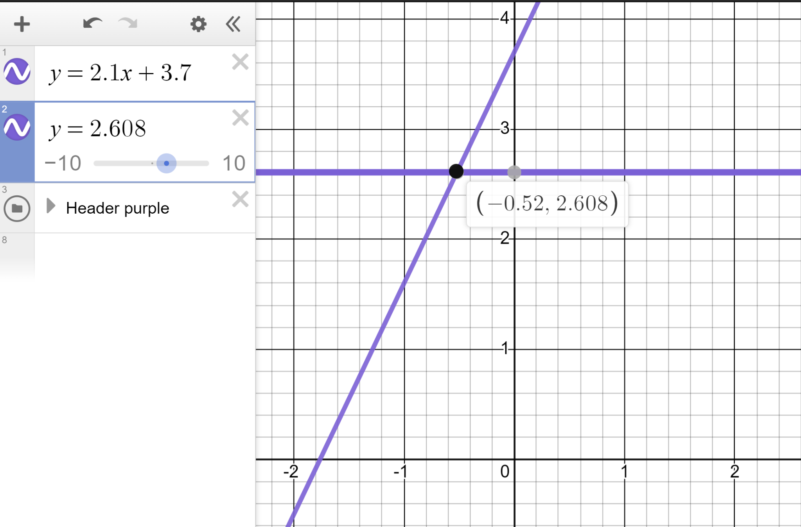
Solving equations with unknowns one side
2) Draw two lines for each to find the solutions to these equations:
c)
2.1x + 3.7 = 2.608
x = −0.52

Slide 25
Solving linear equations graphically using technology
Solving equations with unknowns on one side
Solving equations with unknowns on both sides

Slide 26
Solving equations with unknowns on both sides
We can use Desmos to solve equations with unknowns on both sides such as 3x − 7 = x + 1
Let’s first solve without technology.
3x − 7 | = | x + 1
2x − 7 | = | 1
2x | = | 8
x | = | 4
3x − 7 | = | x + 1
3x − 7 | = | x + 1
2x − 7 | = | 1
3x − 7 | = | x + 1
2x − 7 | = | 1
2x | = | 8
This form looks familiar.
We could plot y = 2x − 7 and y = 1 to see the solution.

Slide 27
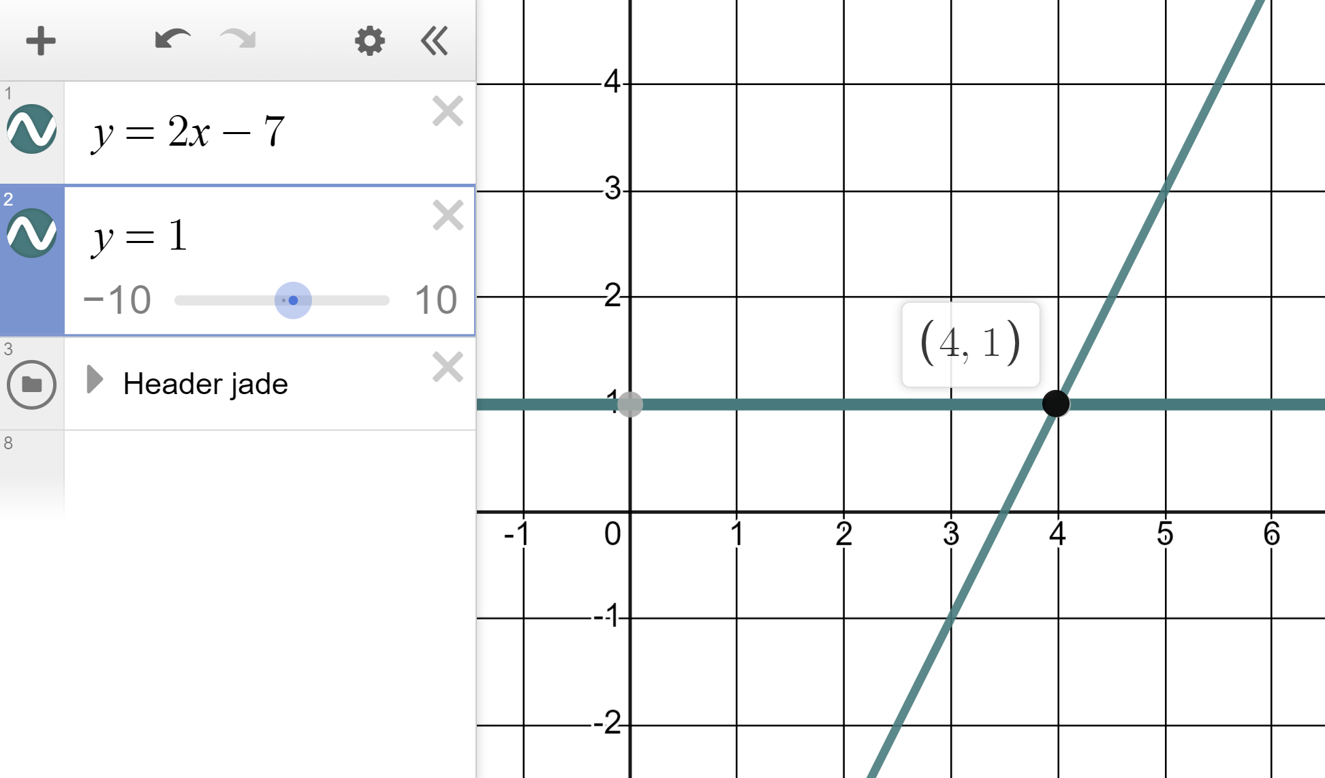
Solving equations with unknowns on both sides
We can use Desmos to solve equations with unknowns on both sides such as 3x − 7 = x + 1
Let’s first solve without technology.
3x − 7 | = | x + 1
2x − 7 | = | 1
2x | = | 8
x | = | 4
3x − 7 | = | x + 1
3x − 7 | = | x + 1
2x − 7 | = | 1
3x − 7 | = | x + 1
2x − 7 | = | 1
2x | = | 8
x = 4

Slide 28
Solving equations with unknowns on both sides
We can use Desmos to solve equations with unknowns on both sides such as 3x − 7 = x + 1
Let’s first solve without technology.
3x − 7 | = | x + 1
2x − 7 | = | 1
2x | = | 8
x | = | 4
3x − 7 | = | x + 1
3x − 7 | = | x + 1
2x − 7 | = | 1
3x − 7 | = | x + 1
2x − 7 | = | 1
2x | = | 8
Could we have plotted this form to solve? The lines y = 2x and y = 8 ?

Slide 29
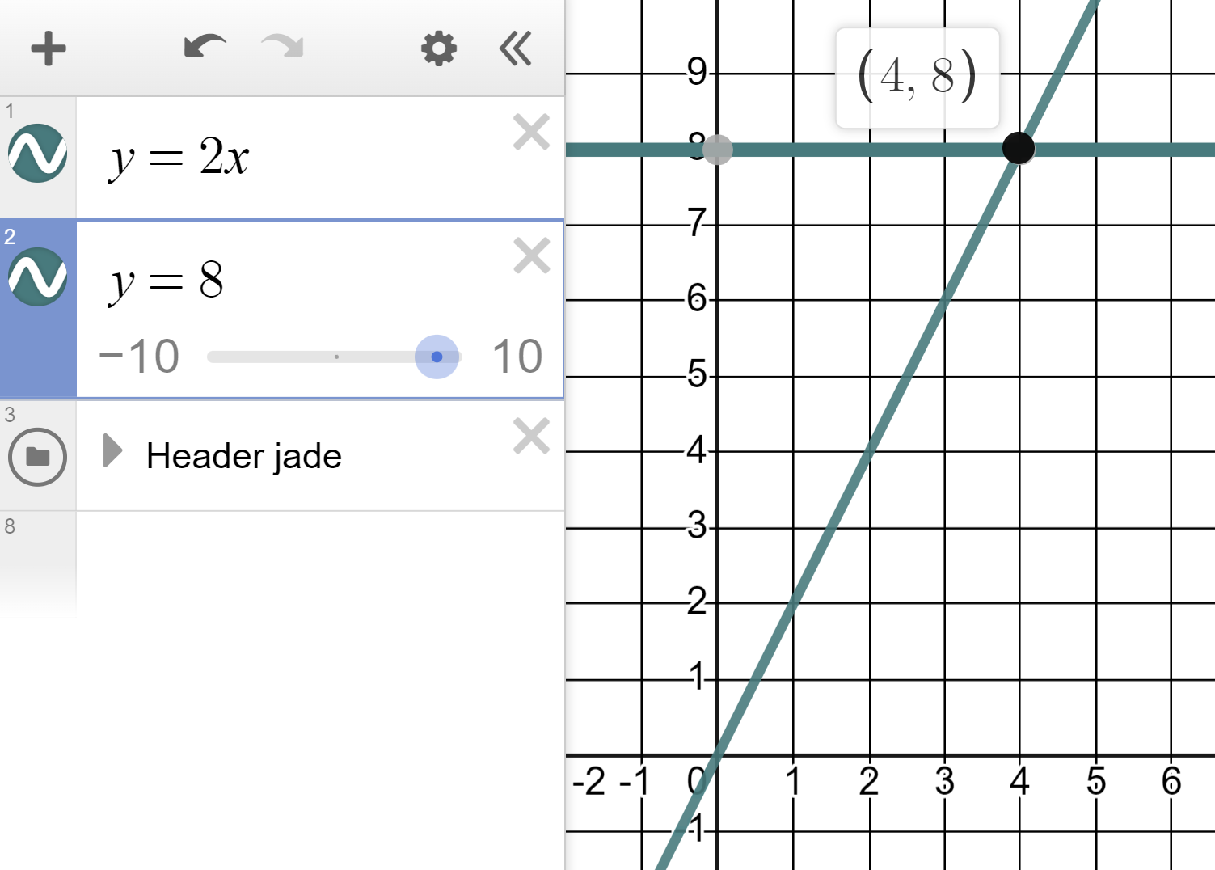
Solving equations with unknowns on both sides
We can use Desmos to solve equations with unknowns on both sides such as 3x − 7 = x + 1
Let’s first solve without technology.
3x − 7 | = | x + 1
2x − 7 | = | 1
2x | = | 8
x | = | 4
3x − 7 | = | x + 1
3x − 7 | = | x + 1
2x − 7 | = | 1
3x − 7 | = | x + 1
2x − 7 | = | 1
2x | = | 8
Same solution, different method.
x = 4

Slide 30
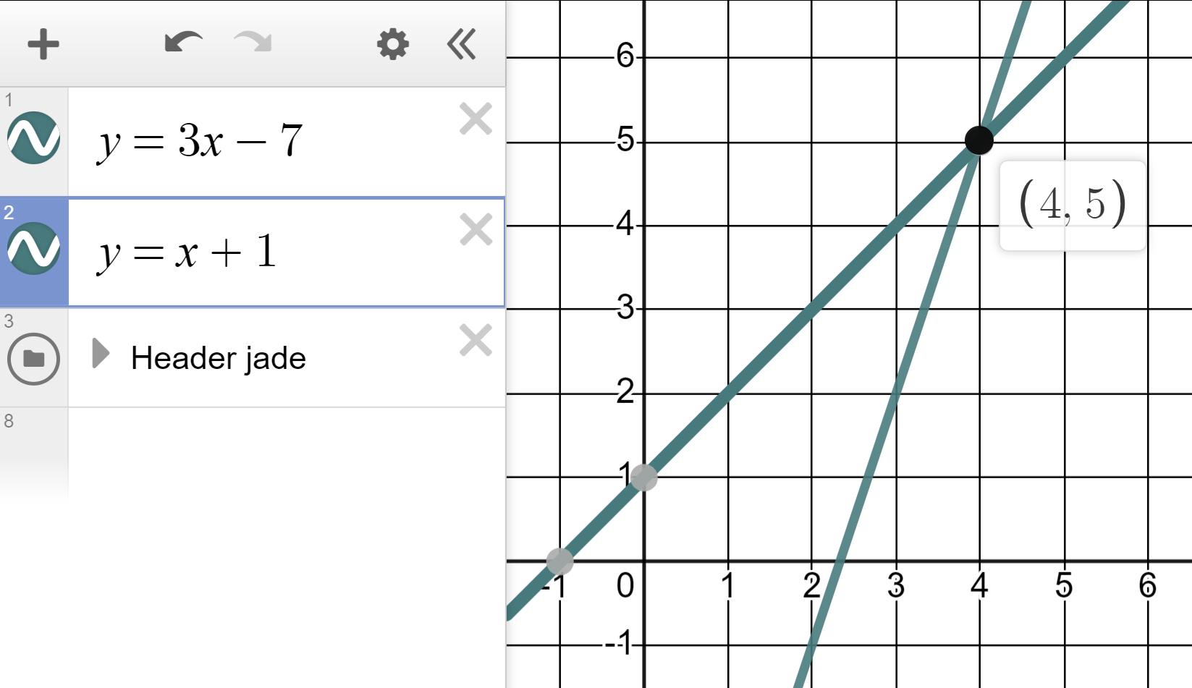
Solving equations with unknowns on both sides
We can use Desmos to solve equations with unknowns on both sides such as 3x − 7 = x + 1
So could we just have plotted this form?
The lines y = 3x − 7 and y = x + 1 ?
3x − 7 | = | x + 1
2x − 7 | = | 1
2x | = | 8
x | = | 4
3x − 7 | = | x + 1
3x − 7 | = | x + 1
2x − 7 | = | 1
3x − 7 | = | x + 1
2x − 7 | = | 1
2x | = | 8
Yes, we get x = 4, the exact same solution.
Notes:
Graphing software means we don’t have to rearrange in order to solve equations with unknowns both sides. We just plot the expressions and identify their intersection.

Slide 31
Solving equations with unknowns on both sides
When solving equations with unknowns both sides we need to manipulate so that the unknowns are on one side before solving.
With Desmos graphing software we don’t need to rearrange. We can plot the two expressions and identify the intersection.
We need to isolate the unknown terms on one side in order to solve equations.

Slide 32
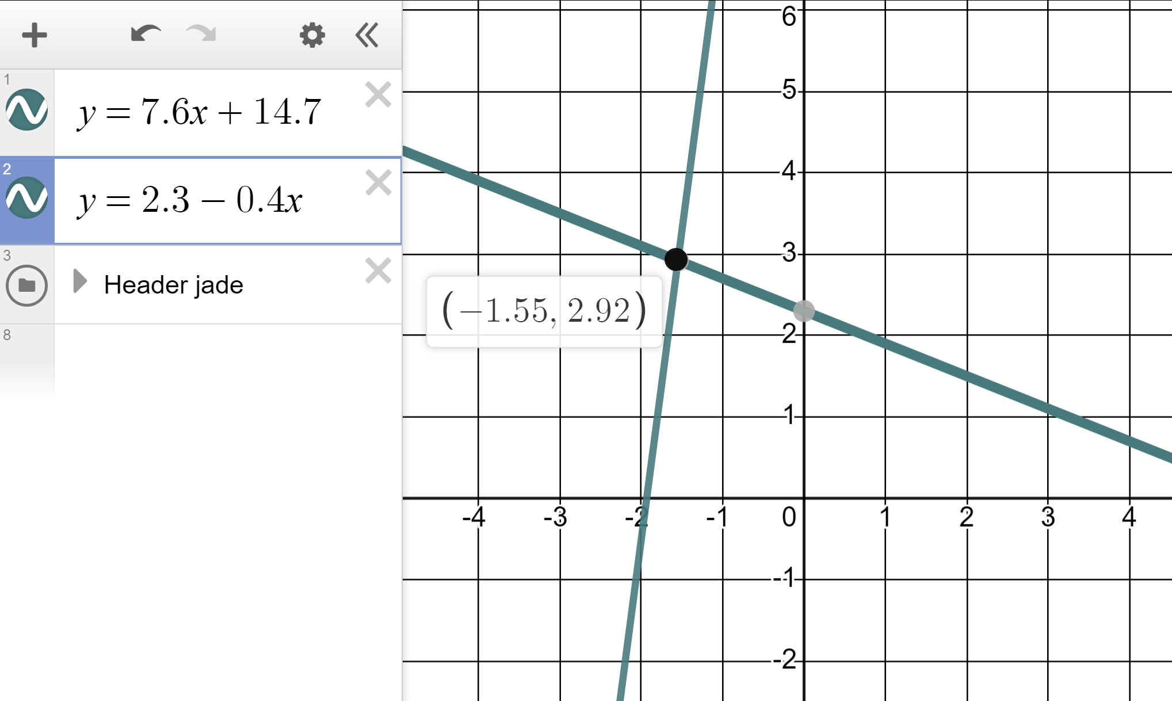
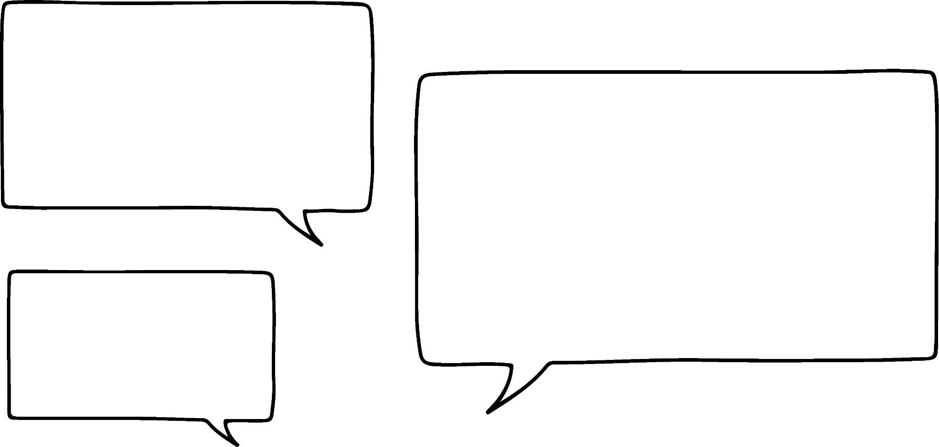
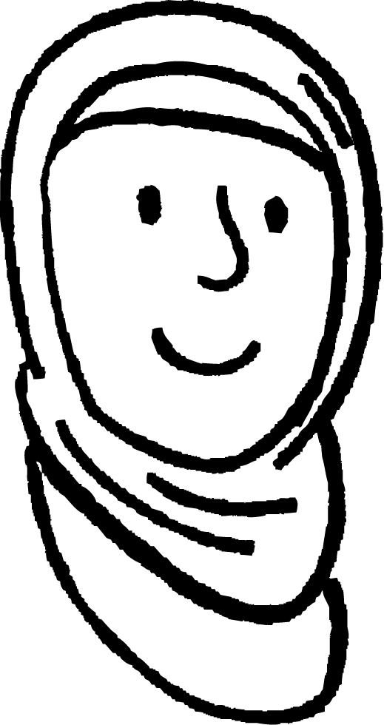

Solving equations with unknowns on both sides
Aisha and Sofia are using Desmos to solve equations with unknowns both sides.
This technology is brilliant! I just solved 2.3 − 0.4x = 7.6x + 14.7 in a few seconds.
Yes, I see. x = −1.55

Slide 33
Solving equations with unknowns on both sides
Aisha and Sofia are using Desmos to solve equations with unknowns both sides.
This technology is brilliant! I just solved 2.3 − 0.4x = 7.6x + 14.7 in a few seconds.
But can you help me? I’m stuck trying to solve 4x − 5 = 4x + 11
Can you see why Sofia has gotten stuck?

Slide 34
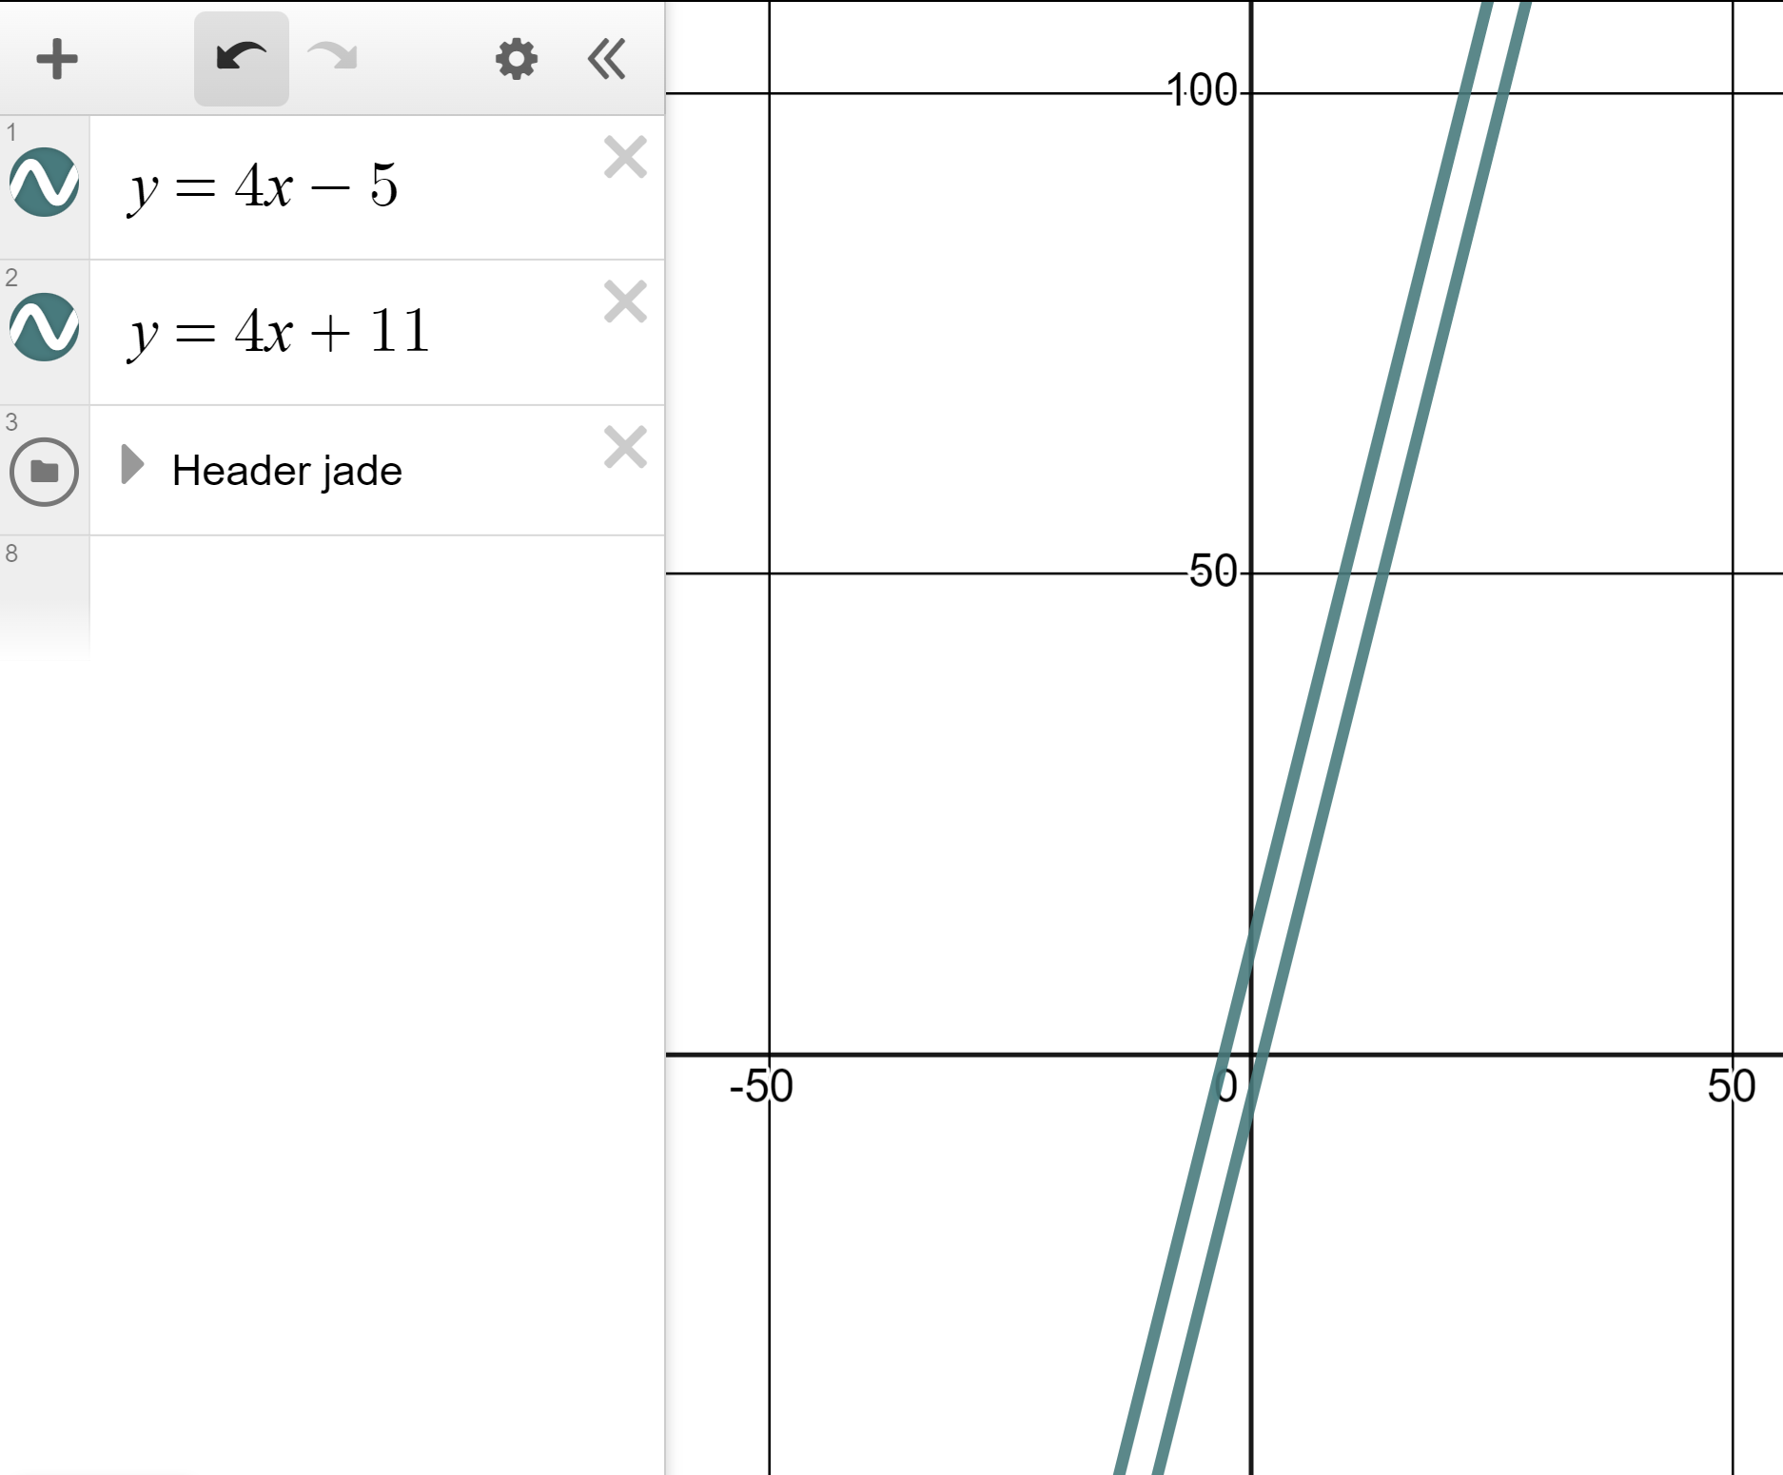
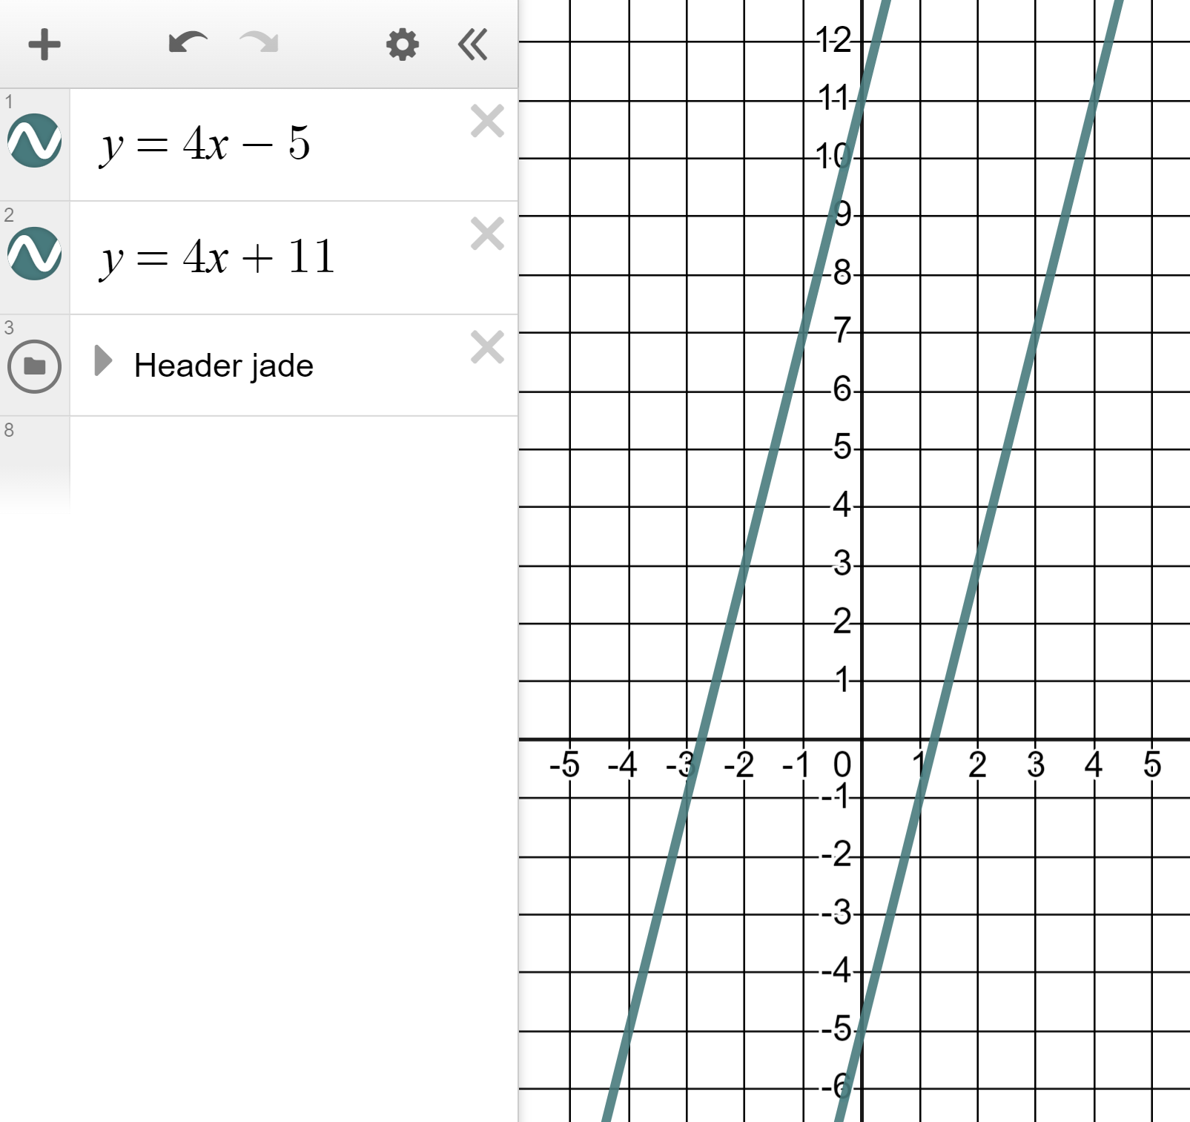
Solving equations with unknowns on both sides
But can you help me? I’m stuck trying to solve 4x − 5 = 4x + 11
4x − 5 and 4x + 11 are parallel lines, they have no intersection. Therefore this equation has no solution.

Slide 35

Solving equations with unknowns on both sides
Which of these equations have solutions?
5x − 1 = x + 5
Different gradients, therefore they intersect. This equation has a solution.
5x − 1 = 7 − 5x
x − 5 = x + 5
Same gradient, therefore no intersection. This equation has no solution.
5x − 1 = 5x + 7

Slide 36
Solving equations with unknowns on both sides
1) Plot pairs of lines and find the intersections to solve the below equations:
a)
9x − 13 = 2x + 8
b)
14x − 268 = 5396 − 18x
c)
0.5x − 8.75 = 4(0.0625 − x)

Slide 37
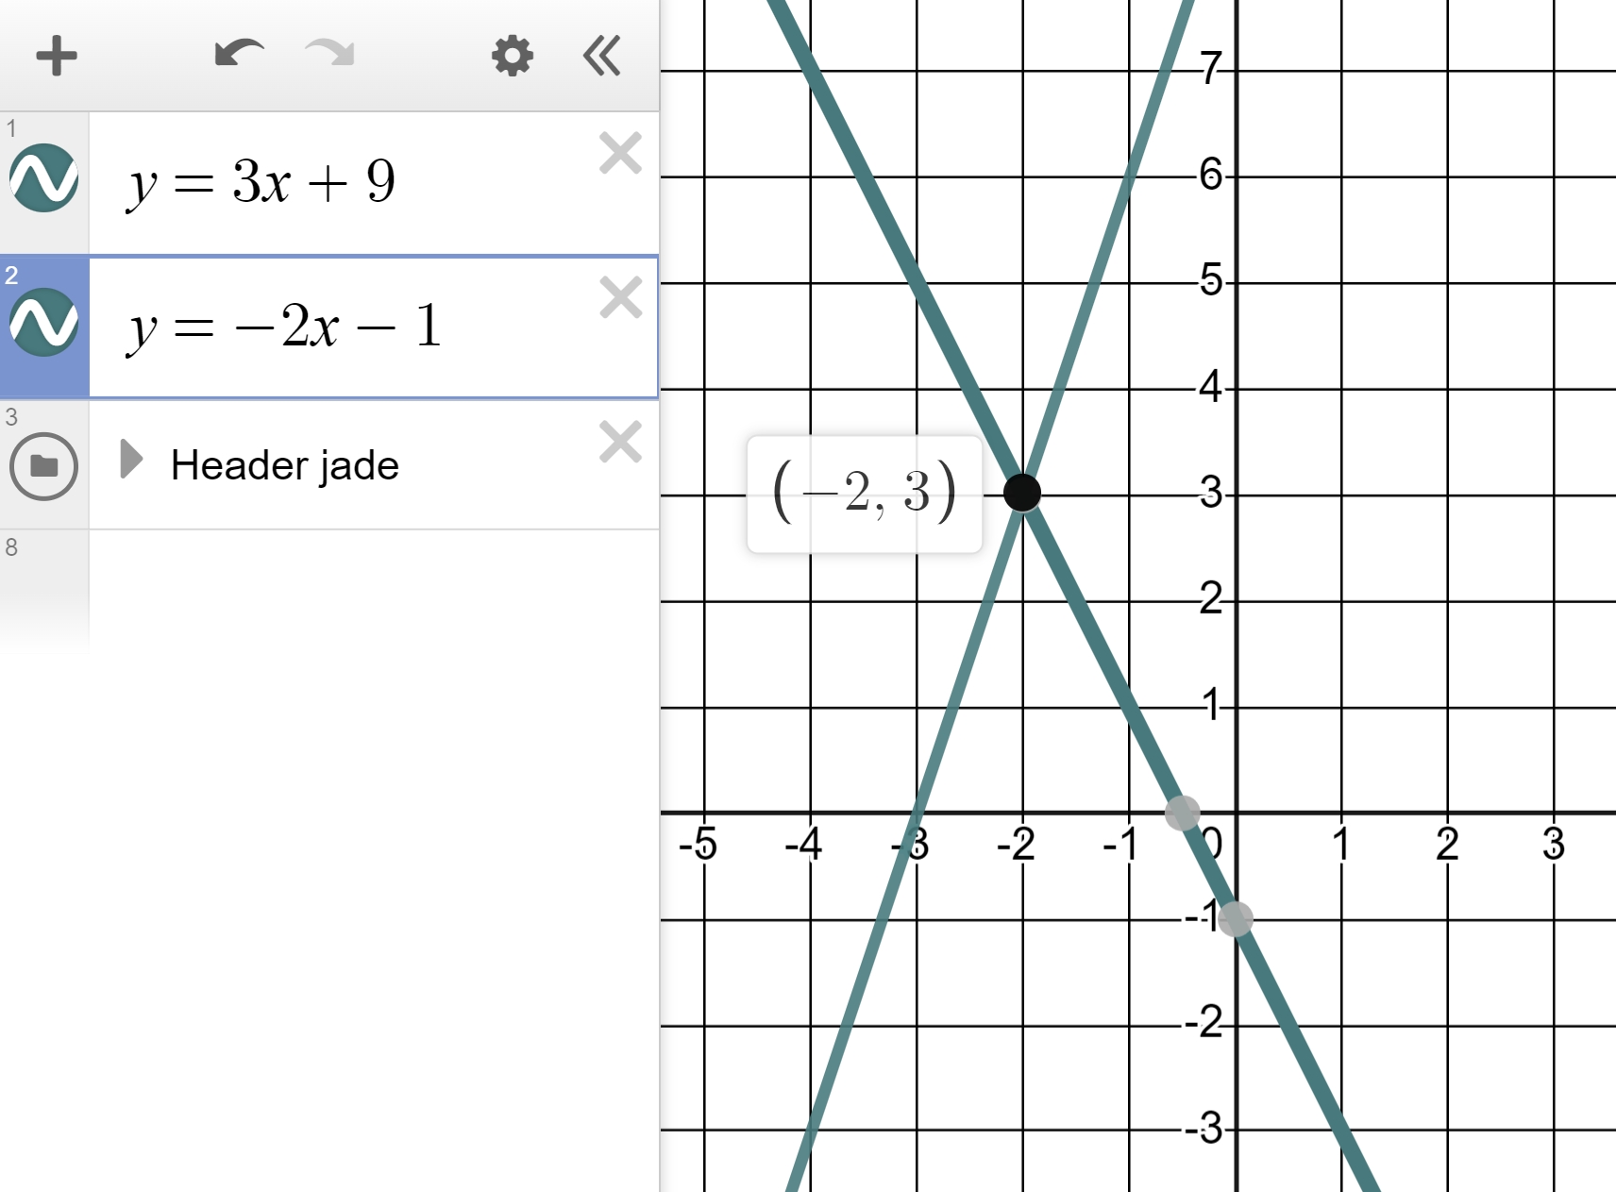
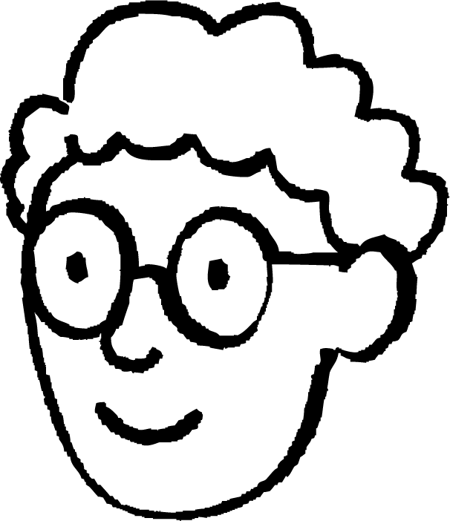
Solving equations with unknowns on both sides
2) Alex says this graph shows that the solution to the equation
3x + 9 = −2x − 1 is x = 3
Alex is wrong.
Identify the correct solution and write a sentence explaining Alex’s error to him.

Slide 38
Solving equations with unknowns on both sides
3) One of the below equations has no solution.
Identify which one it is and show why it has no solution.
a)
8 − 3x = 3x + 2
b)
11x − 25 = 25x + 7
c)
6x − 11 = 2(3x + 4)

Slide 39
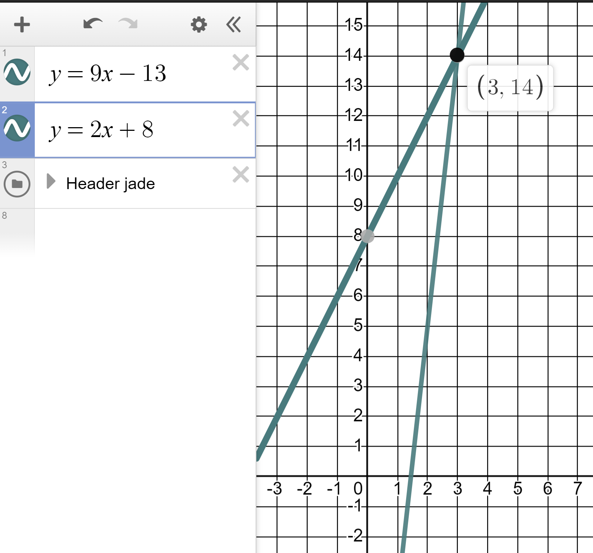
Solving equations with unknowns on both sides
1) Plot pairs of lines and find the intersections to solve the below equations:
a)
9x − 13 = 2x + 8
Intersect at (3, 14) therefore solution is x = 3

Slide 40
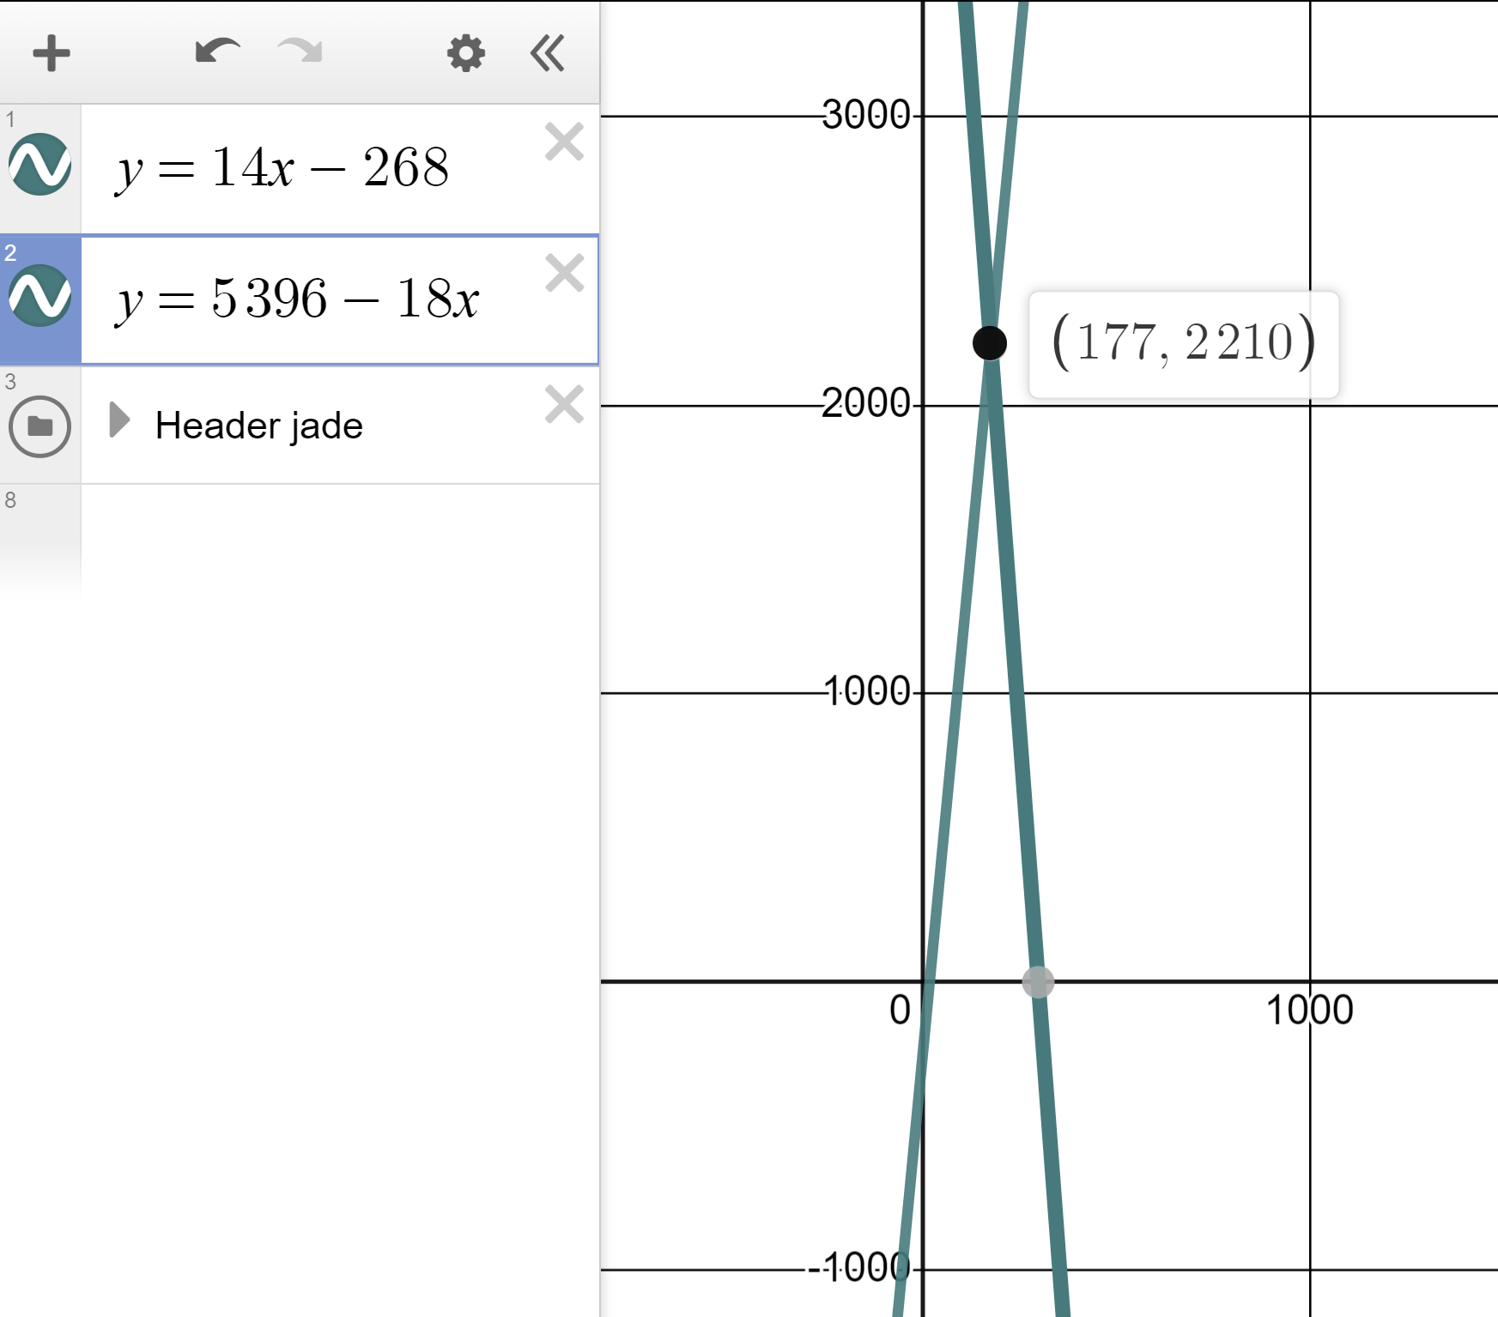
Solving equations with unknowns on both sides
1) Plot pairs of lines and find the intersections to solve the below equations:
b)
14x − 268 = 5396 − 18x
Intersect at (177, 2210) therefore solution is x = 177

Slide 41
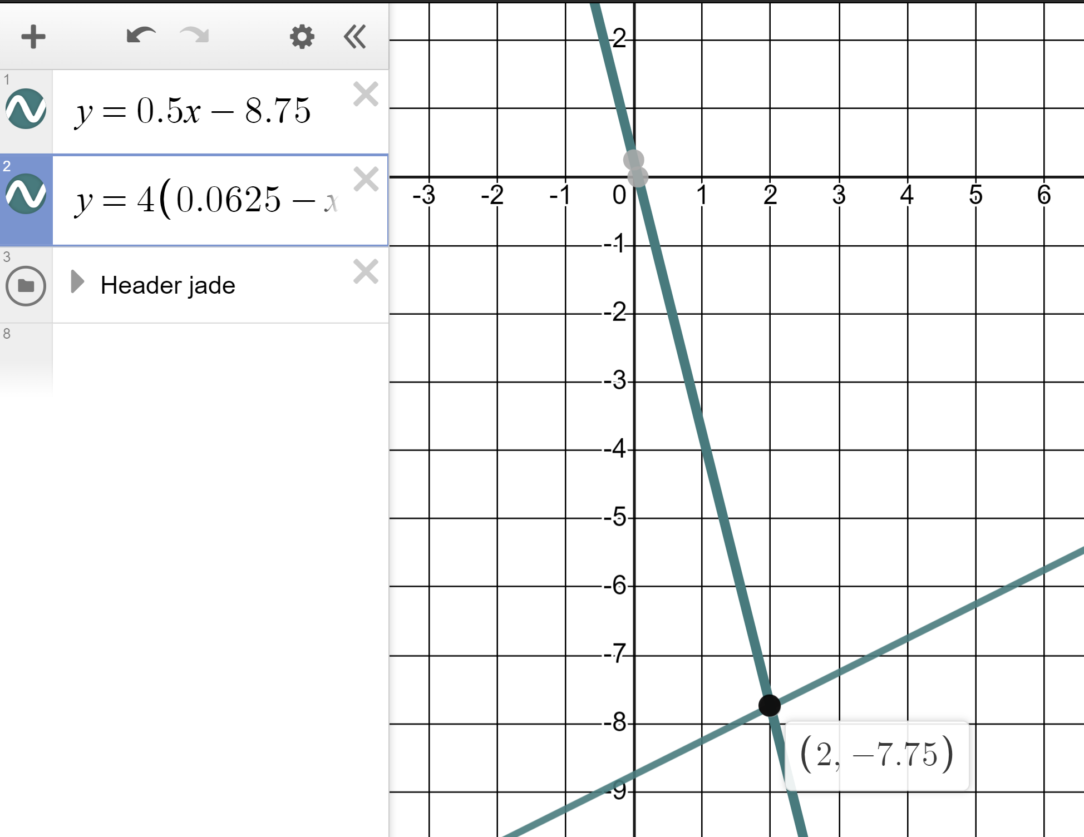
Solving equations with unknowns on both sides
1) Plot pairs of lines and find the intersections to solve the below equations:
c)
0.5x − 8.75 = 4(0.0625 − x)
Intersect at (2, −7.75) therefore solution is x = 2

Slide 42
Solving equations with unknowns on both sides
2) Alex says this graph shows that the solution to the equation
3x + 9 = −2x − 1 is x = 3
You might have written:
x = −2 is the solution
3 is the value of both expressions when x = −2

Slide 43
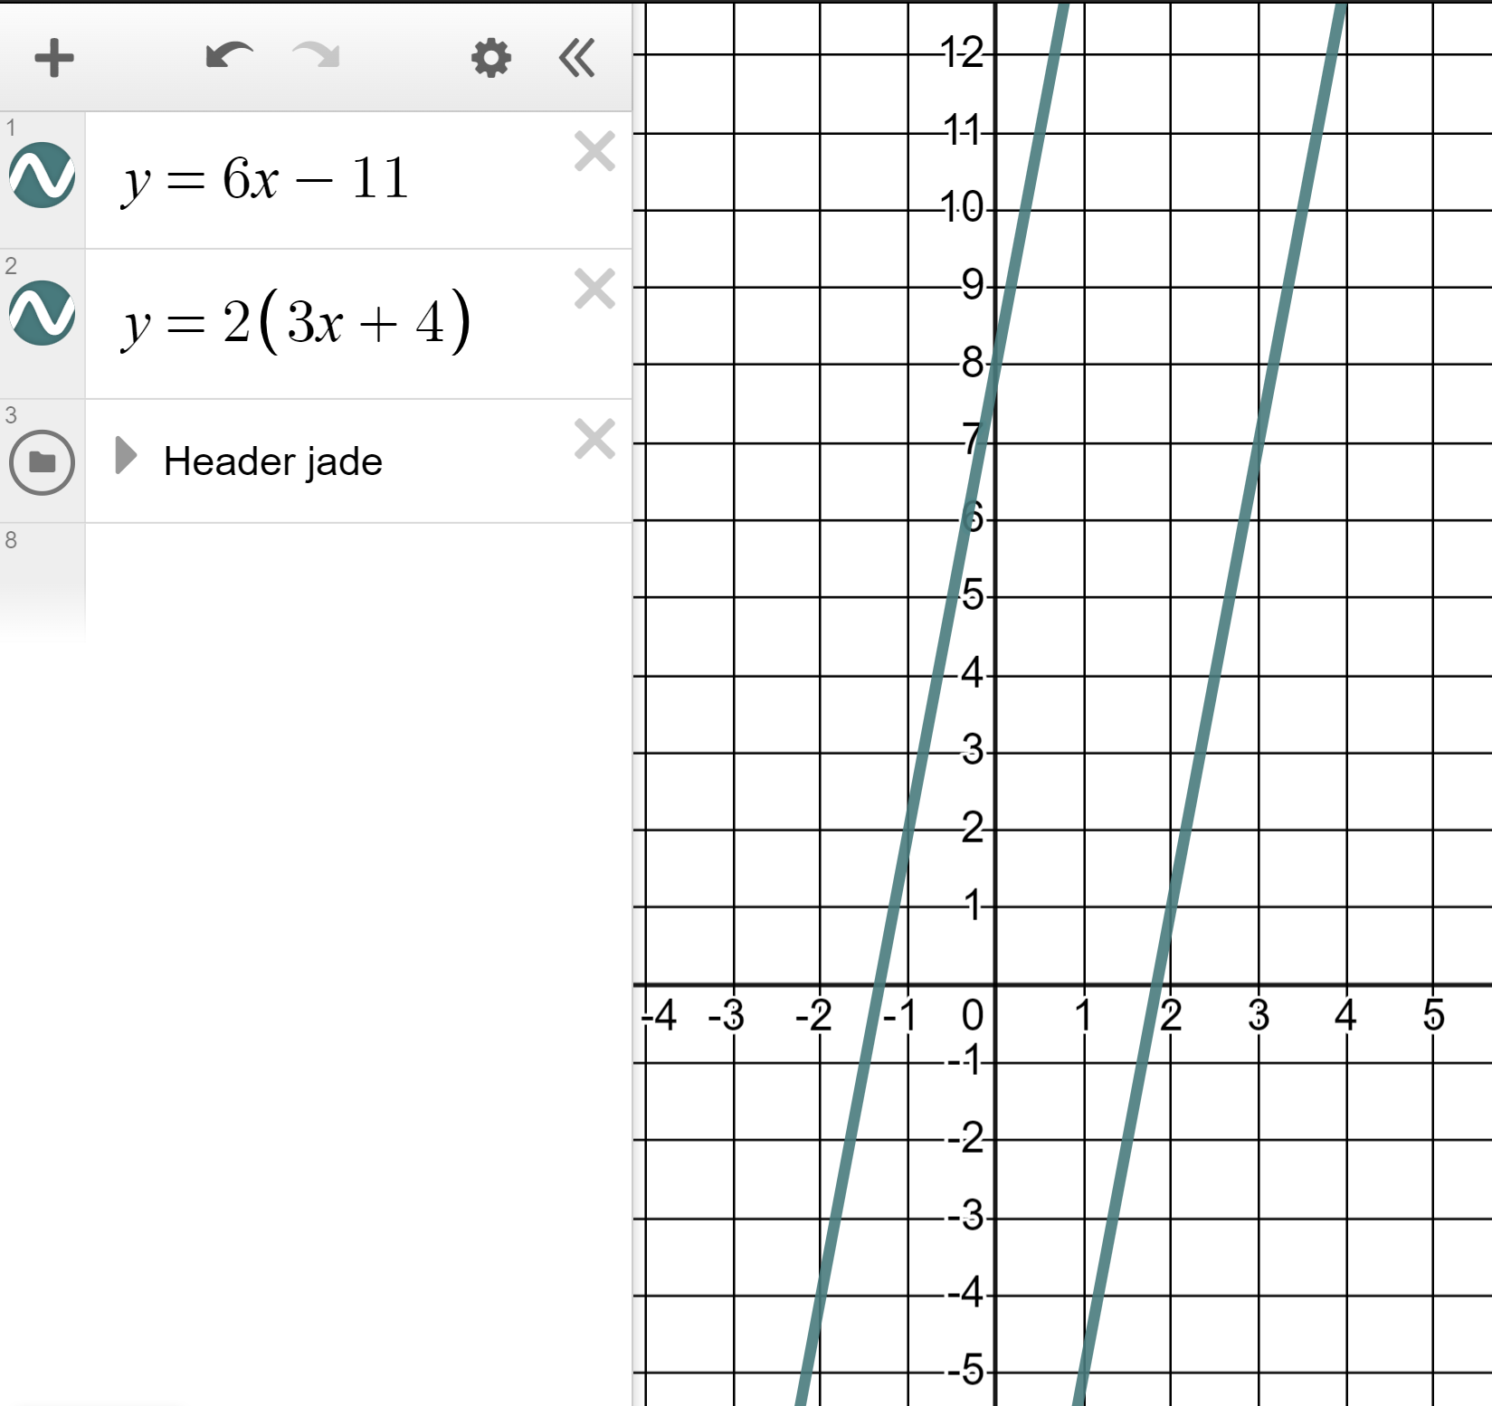
Solving equations with unknowns on both sides
3) One of the below equations has no solution.
Identify which one it is and show why it has no solution.
a)
8 − 3x = 3x + 2
Different gradients therefore intersection and a solution.
b)
11x − 25 = 25x + 7
Different gradients therefore intersection and a solution.
c)
6x − 11 = 2(3x + 4)
6x − 11 = 6x + 8
Same gradient. No intersection, no solution.

Slide 44
Solving linear equations graphically using technology
We can use dynamic software to solve linear equations graphically by identifying the x-coordinate of the intersecting points of the lines.

Slide 45

© Oak National Academy 2023.
Produced in partnership with Mathematics in Education and Industry.
Licensed on the Open Government Licence v3.0, except where otherwise stated. See Oak terms and conditions.

